Slide 1

Feedback Control System Unit 1_3 Time Analysis

Slide 2
Poles of a Transfer Function
The poles of a transfer function are
the values of the Laplace transform variable, s, that cause the transfer function to become infinite or
any roots of the denominator of the transfer function that are common to roots of the numerator.

Slide 3
Poles of a Transfer Function
The first part completely satisfy definition of the poles of a transfer function i.e. the roots of the characteristic polynomial in the denominator are values of ‘s’ that make the transfer function infinite, so they are thus poles.
However, if a factor of the denominator can be canceled by the same factor in the numerator, the root of this factor no longer causes the transfer function to become infinite.
In control systems, we often refer to the root of the canceled factor in the denominator as a pole even though the transfer function will not be infinite at this value. Hence, the later part is included in the definition.

Slide 4
Zeros of a Transfer Function
The zeros of a transfer function are
the values of the Laplace transform variable, s, that cause the transfer function to become zero, or
any roots of the numerator of the transfer function that are common to roots of the denominator.

Slide 5
Zeros of a Transfer Function
The first part completely satisfy definition of the poles of a transfer function i.e. the roots of the characteristic polynomial in the denominator are values of ‘s’ that make the transfer function zero, so they are thus zeros.
However, if a factor of the numerator can be canceled by the same factor in the denominator, the root of this factor no longer causes the transfer function to become zero.
In control systems, we often refer to the root of the canceled factor in the numerator as a zero even though the transfer function will not be zero at this value. Hence, the later part is included in the definition.

Slide 6
Poles and Zeros of a First-Order System
a b
Given the transfer function G(s) = (s+2)/(s+5) in figure (a), a pole exists at s = - 5, and a zero exists at - 2. These pole and zero are are plotted on the complex s-plane in figure (b).
To show the properties of the poles and zeros, let us find the unit step response of the system.

Slide 7
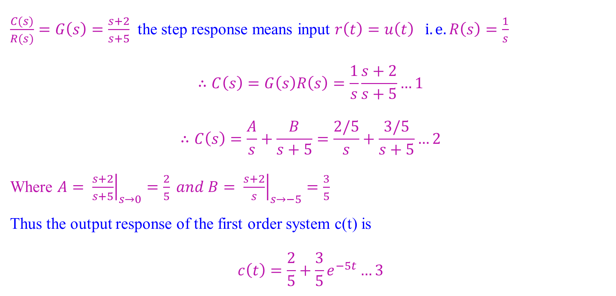
Poles and Zeros of a First-Order System & System Response
$\frac{C(s)}{R(s)}=G\left(s\right)=\frac{s+2}{s+5}$ the step response means input $r\left(t\right)=u\left(t\right) i.e. R\left(s\right)=\frac{1}{s}$
$$∴C\left(s\right)=G\left(s\right)R\left(s\right)=\frac{1}{s}\frac{s+2}{s+5}…1$$
$$∴C\left(s\right)=\frac{A}{s}+\frac{B}{s+5}=\frac{2/5}{s}+\frac{3/5}{s+5}…2$$
Where $A= {\left.\frac{s+2}{s+5}\right|}_{s→0}=\frac{2}{5} and B= {\left.\frac{s+2}{s}\right|}_{s→−5}=\frac{3}{5}$
Thus the output response of the first order system c(t) is
$$c\left(t\right)=\frac{2}{5}+\frac{3}{5}e^{−5t}…3$$

Slide 8
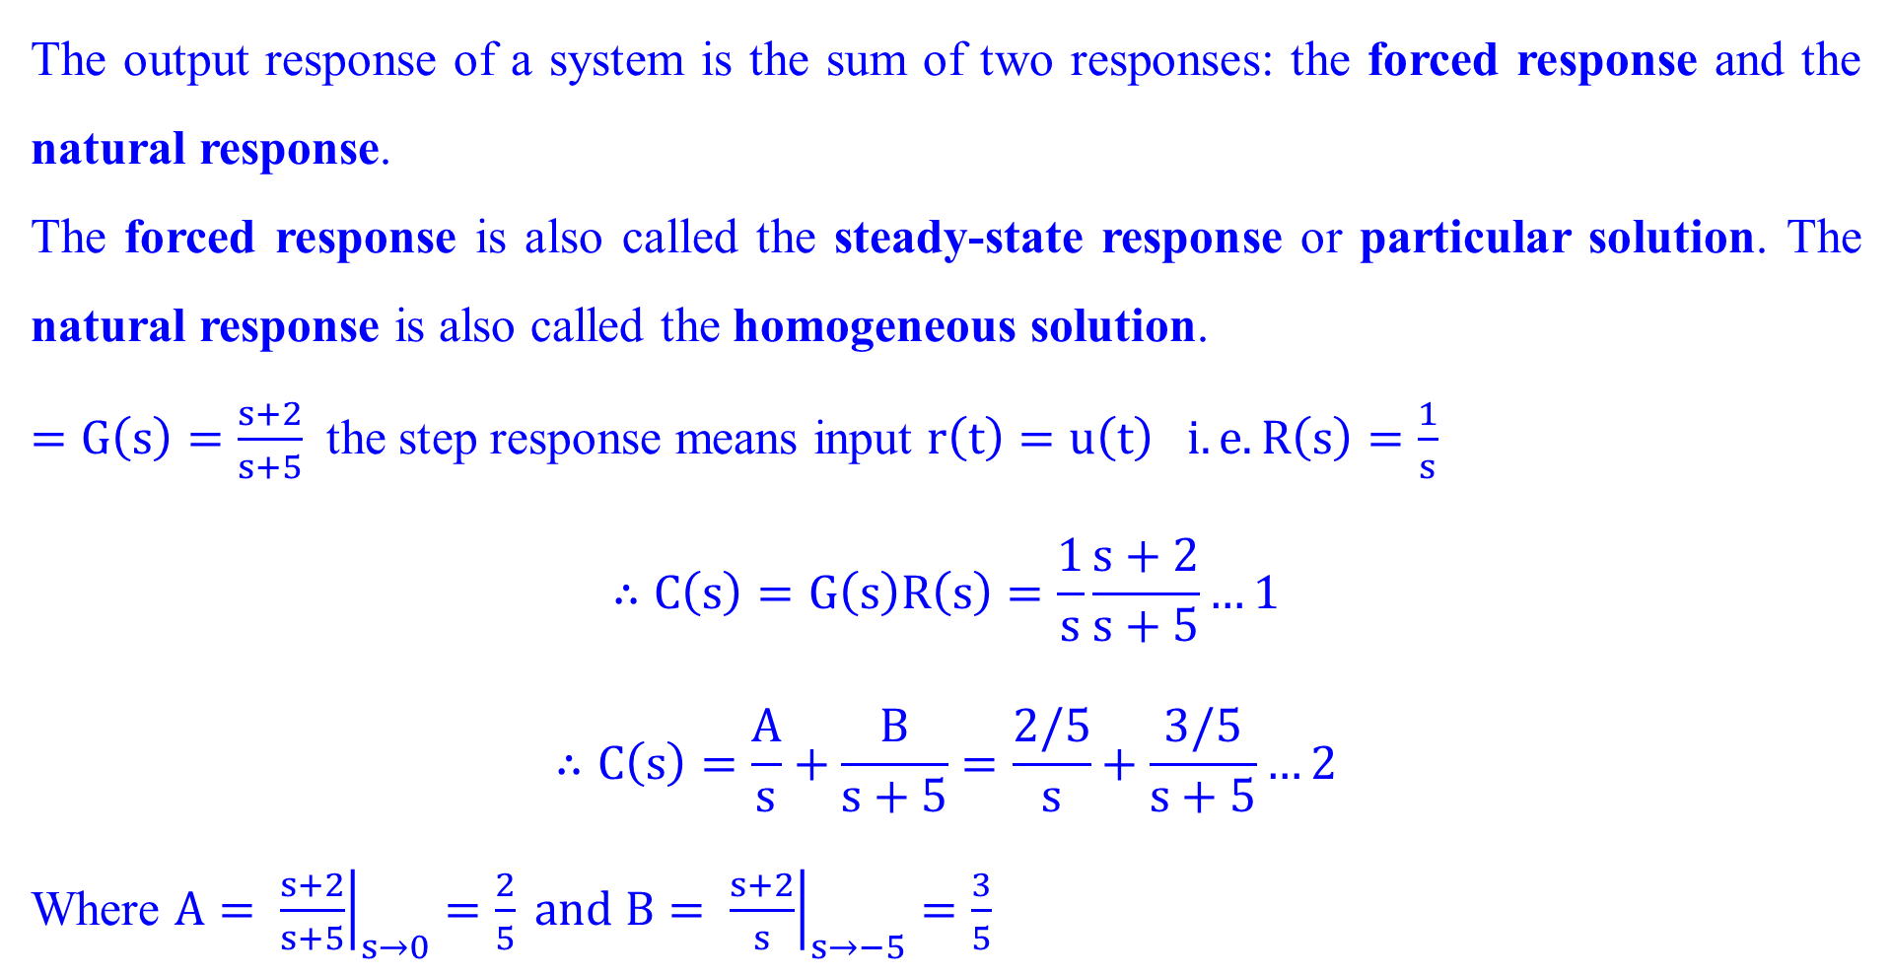
Poles and Zeros of a First-Order System & System Response
The output response of a system is the sum of two responses: the forced response and the natural response.
The forced response is also called the steady-state response or particular solution. The natural response is also called the homogeneous solution.
$=G\left(s\right)=\frac{s+2}{s+5}$ the step response means input $r\left(t\right)=u\left(t\right) i.e. R\left(s\right)=\frac{1}{s}$
$$∴C\left(s\right)=G\left(s\right)R\left(s\right)=\frac{1}{s}\frac{s+2}{s+5}…1$$
$$∴C\left(s\right)=\frac{A}{s}+\frac{B}{s+5}=\frac{2/5}{s}+\frac{3/5}{s+5}…2$$
Where $A= {\left.\frac{s+2}{s+5}\right|}_{s→0}=\frac{2}{5} and B= {\left.\frac{s+2}{s}\right|}_{s→−5}=\frac{3}{5}$

Slide 9
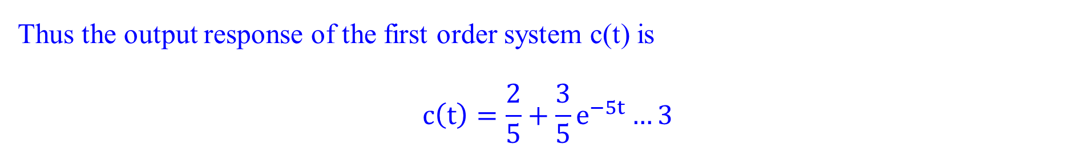
Poles and Zeros of a First-Order System & System Response
Thus the output response of the first order system c(t) is
$$c\left(t\right)=\frac{2}{5}+\frac{3}{5}e^{−5t}…3$$

Slide 10
Poles and Zeros of a First-Order System & System Response
Evolution of a system response. The blue arrows show the evolution of the response component generated by the pole or zero.

Slide 11
Poles and Zeros of a First-Order System & System Response
The conclusions are
A pole of the input function generates the form of the forced response (that is, the pole at the origin generated a step function at the output).
A pole of the transfer function generates the form of the natural response (that is, the pole at -5 generated e^{-5t} ).
A pole on the real axis generates an exponential response of the form e^{-αt} , where -α is the pole location on the real axis. Thus, the farther to the left a pole is on the negative real axis, the faster the exponential transient response will decay to zero.
The zeros and poles generate the amplitudes for both the forced and natural responses

Slide 12
Poles and Zeros of a First-Order System & System Response
Effect of a real-axis pole upon transient response

Slide 13
Poles and Zeros of a First-Order System & System Response
Find the output c(t) Specify the forced and natural parts of the solution.

Slide 14
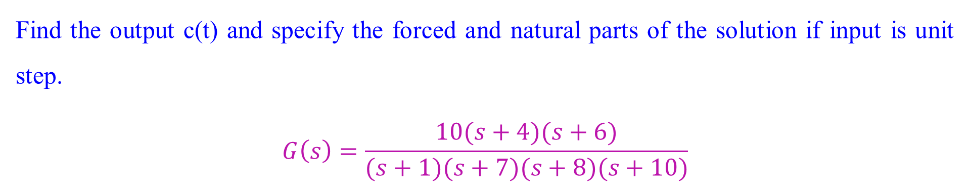
Poles and Zeros of a First-Order System & System Response
Find the output c(t) and specify the forced and natural parts of the solution if input is unit step.
$$G\left(s\right)=\frac{10(s+4)(s+6)}{(s+1)(s+7)(s+8)(s+10)}$$

Slide 15
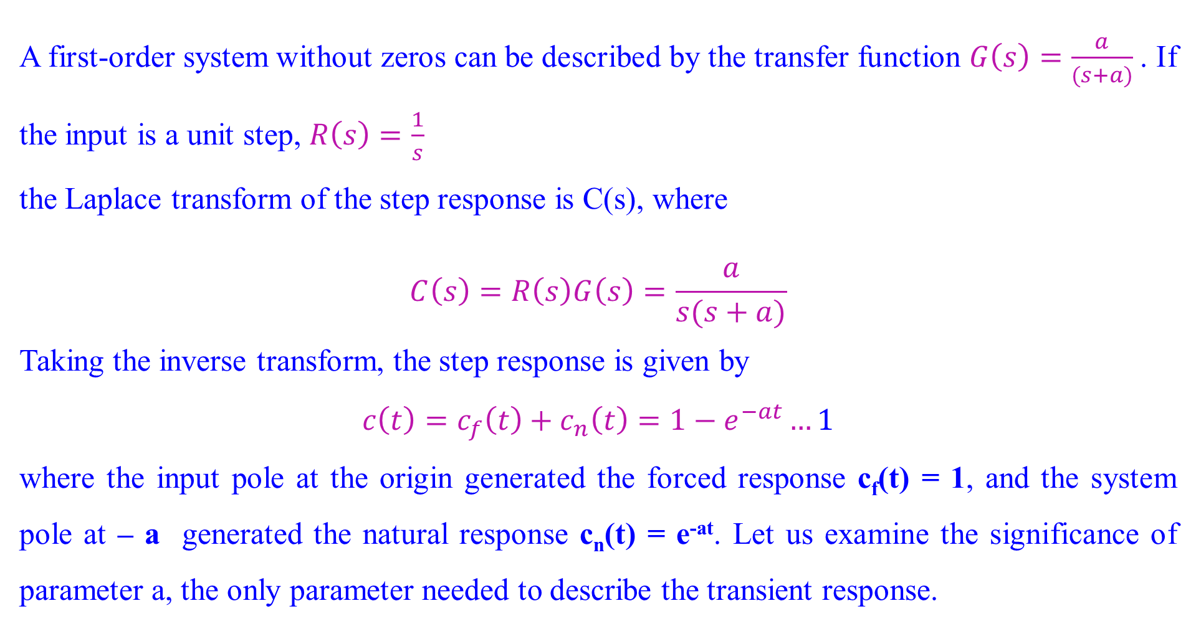
First-Order Systems without zero
A first-order system without zeros can be described by the transfer function $G\left(s\right)=\frac{a}{(s+a)}$. If the input is a unit step, $R\left(s\right)=\frac{1}{s}$
the Laplace transform of the step response is C(s), where
$$C\left(s\right)=R\left(s\right)G\left(s\right)=\frac{a}{s(s+a)}$$
Taking the inverse transform, the step response is given by
$$c\left(t\right)=c_{f}\left(t\right)+c_{n}\left(t\right)=1−e^{−at}…1$$
where the input pole at the origin generated the forced response c_{f}(t) = 1, and the system pole at – a generated the natural response c_{n}(t) = e^{-at}. Let us examine the significance of parameter a, the only parameter needed to describe the transient response.

Slide 16
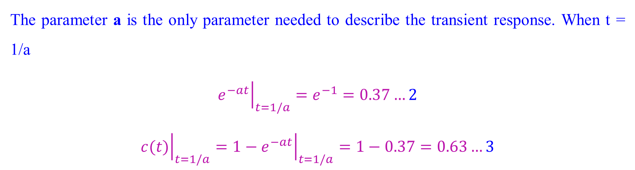
First-Order Systems without zero
The parameter a is the only parameter needed to describe the transient response. When t = 1/a
$${\left.e^{−at}\right|}_{t=1/a}=e^{−1}=0.37…2$$
$${\left.c(t)\right|}_{t=1/a}={\left.{1−e}^{−at}\right|}_{t=1/a}=1−0.37=0.63…3$$

Slide 17
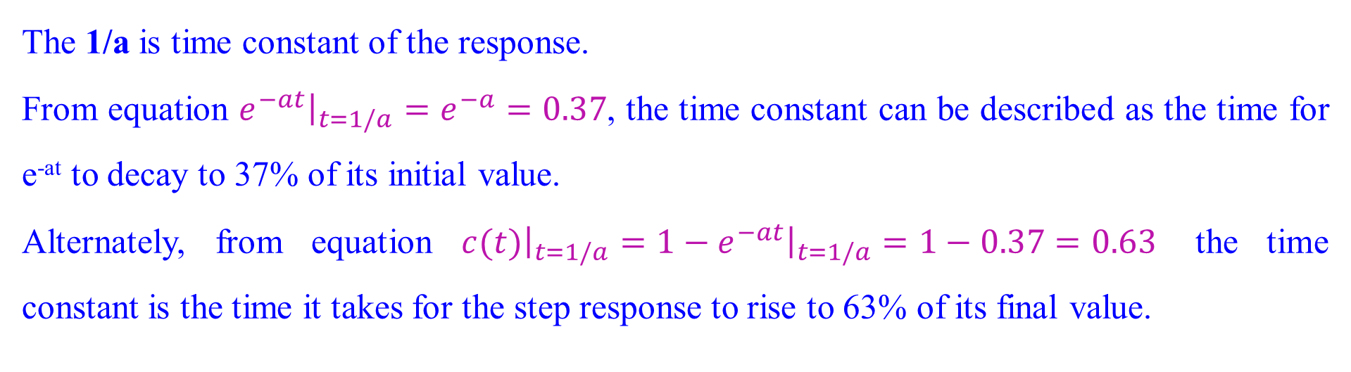
Time constant
The 1/a is time constant of the response.
From equation ${\left.e^{−at}\right|}_{t=1/a}=e^{−a}=0.37$, the time constant can be described as the time for e^{-at} to decay to 37% of its initial value.
Alternately, from equation ${\left.c(t)\right|}_{t=1/a}={\left.{1−e}^{−at}\right|}_{t=1/a}=1−0.37=0.63$ the time constant is the time it takes for the step response to rise to 63% of its final value.

Slide 18
Time constant
First-order system response to a unit step

Slide 19
Time constant
The reciprocal of the time constant has the units (1/seconds), or frequency.
Thus, the parameter ‘a’ the exponential frequency.
The derivative of e^{-at} is ‘-a’ when t = 0, a is the initial rate of change of the exponential at t = 0.
Thus, the time constant can be considered a transient response specification for a first order system, since it is related to the speed at which the system responds to a step input.
The time constant can also be evaluated from the pole plot. Since the pole of the transfer function is at ‘-a’, we can say the pole is located at the reciprocal of the time constant, and the farther the pole from the imaginary axis, the faster the transient response.

Slide 20
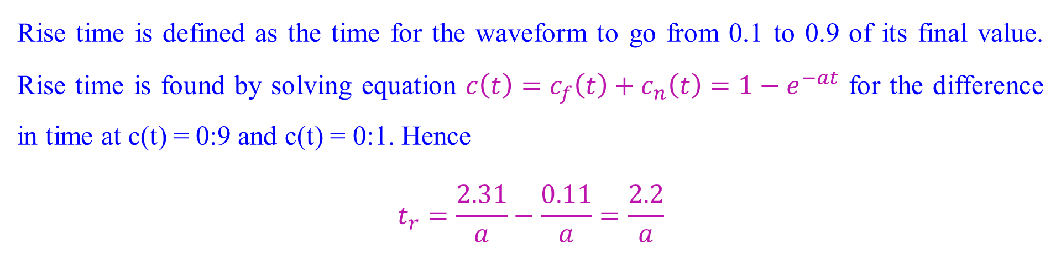
Rise Time, T_{r}
Rise time is defined as the time for the waveform to go from 0.1 to 0.9 of its final value. Rise time is found by solving equation $c\left(t\right)=c_{f}\left(t\right)+c_{n}\left(t\right)=1−e^{−at}$ for the difference in time at c(t) = 0:9 and c(t) = 0:1. Hence
$$t_{r}=\frac{2.31}{a}−\frac{0.11}{a}=\frac{2.2}{a}$$

Slide 21
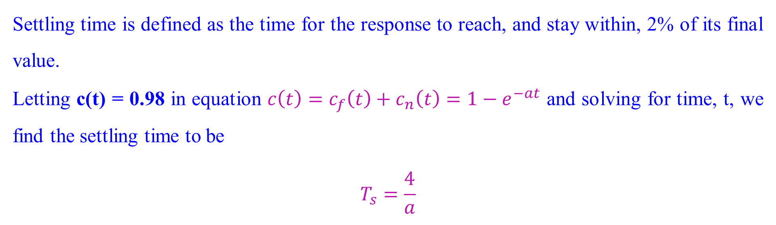
Settling Time, T_{s}
Settling time is defined as the time for the response to reach, and stay within, 2% of its final value.
Letting c(t) = 0.98 in equation $c\left(t\right)=c_{f}\left(t\right)+c_{n}\left(t\right)=1−e^{−at}$ and solving for time, t, we find the settling time to be
$$T_{s}=\frac{4}{a}$$

Slide 22
Transfer function from laboratory test
It is not always possible or practical to obtain a system’s transfer function analytically. Because the system is closed, and the component parts are not easily identifiable.
Since the transfer function is a representation of the system from input to output, the system’s step response can help to find out the transfer function even though the inner construction is not known.
With a step input, we can measure the time constant and the steady-state value, from which the transfer function can be calculated

Slide 23
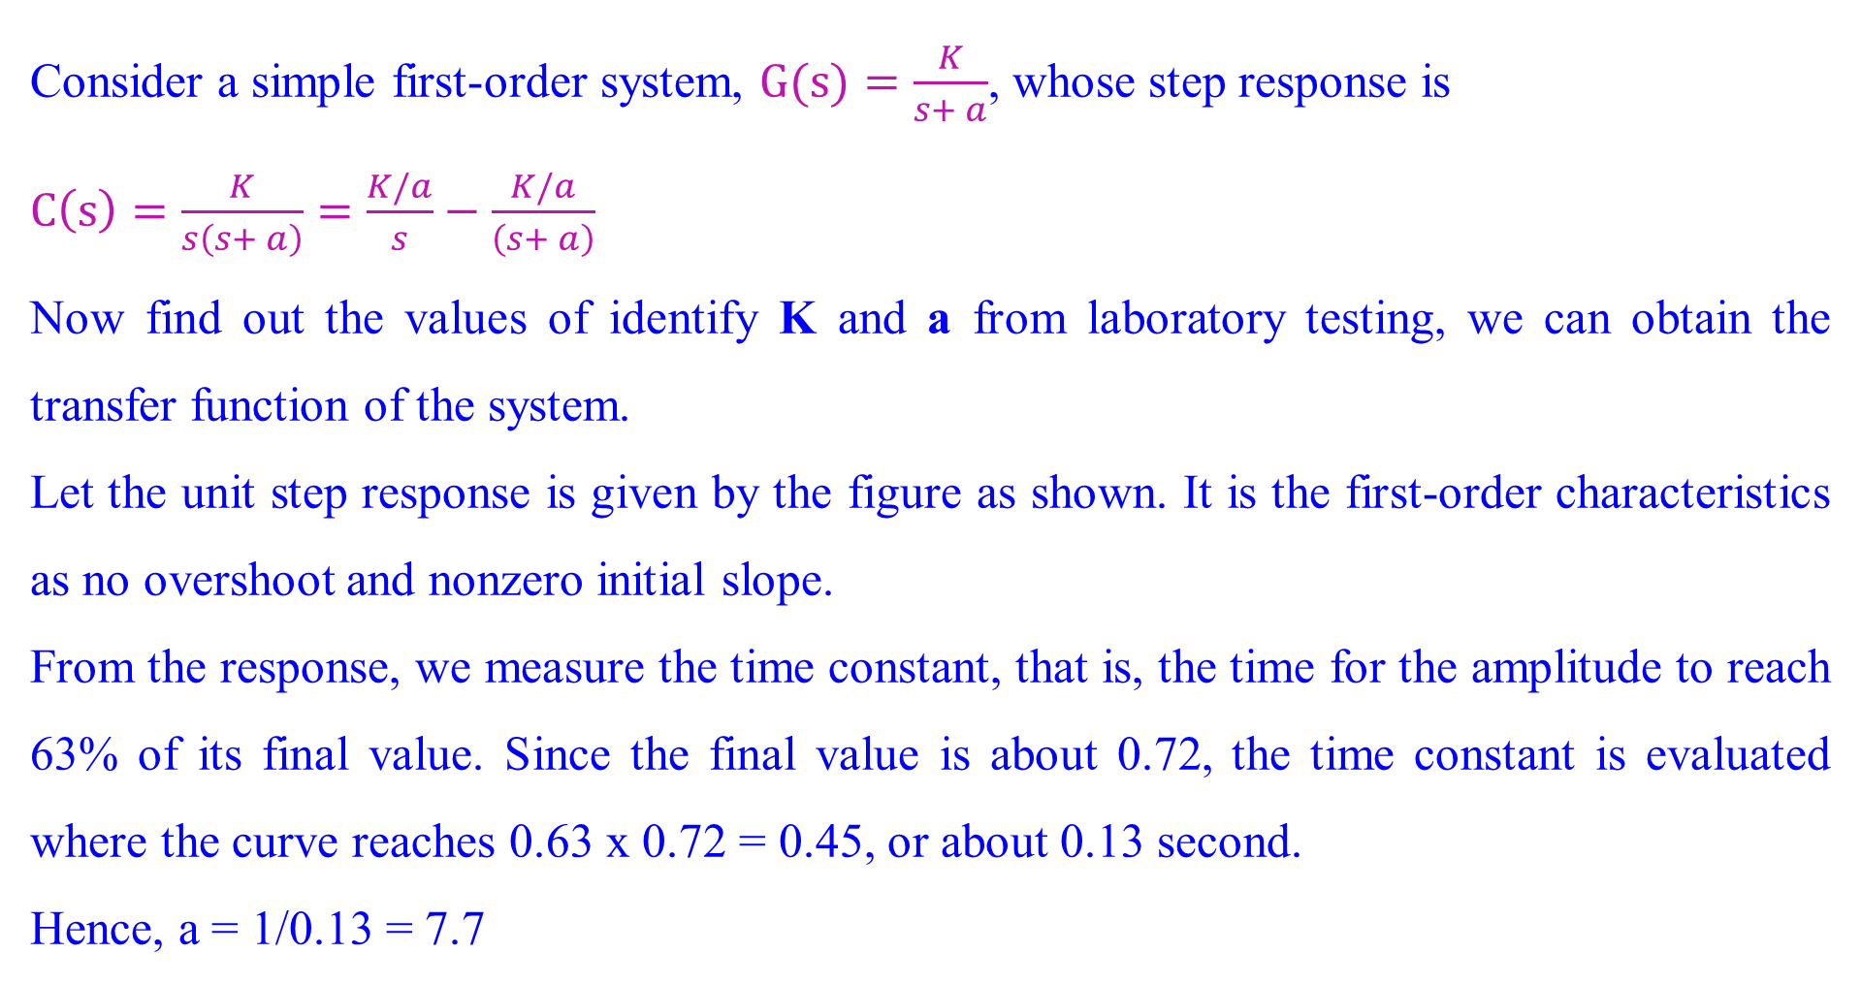
Transfer function from laboratory test
Consider a simple first-order system, $G(s)=\frac{K}{s+ a}$, whose step response is
$C\left(s\right)=\frac{K}{s\left(s+ a\right)}=\frac{K/a}{s}−\frac{K/a}{\left(s+ a\right)}$
Now find out the values of identify K and a from laboratory testing, we can obtain the transfer function of the system.
Let the unit step response is given by the figure as shown. It is the first-order characteristics as no overshoot and nonzero initial slope.
From the response, we measure the time constant, that is, the time for the amplitude to reach 63% of its final value. Since the final value is about 0.72, the time constant is evaluated where the curve reaches 0.63 x 0.72 = 0.45, or about 0.13 second.
Hence, a = 1/0.13 = 7.7

Slide 24
Transfer function from laboratory test
Laboratory results of a system step response test

Slide 25
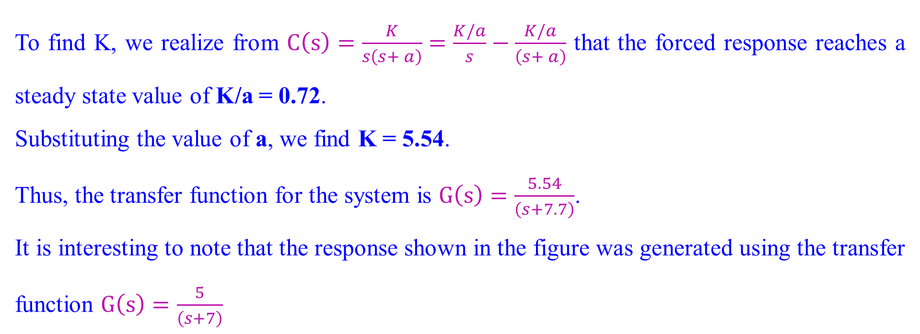
Transfer function from laboratory test
To find K, we realize from $C\left(s\right)=\frac{K}{s\left(s+ a\right)}=\frac{K/a}{s}−\frac{K/a}{\left(s+ a\right)}$ that the forced response reaches a steady state value of K/a = 0.72.
Substituting the value of a, we find K = 5.54.
Thus, the transfer function for the system is $G\left(s\right)=\frac{5.54}{\left(s+7.7\right)}$.
It is interesting to note that the response shown in the figure was generated using the transfer function $G\left(s\right)=\frac{5}{\left(s+7\right)}$

Slide 26
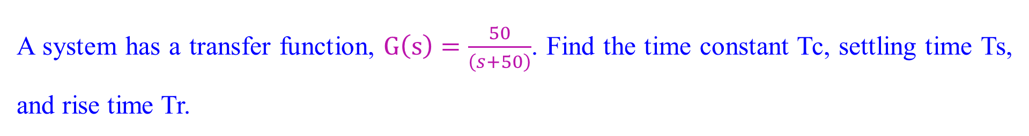
Transfer function from laboratory test
A system has a transfer function, $G\left(s\right)=\frac{50}{\left(s+50\right)}$. Find the time constant Tc, settling time Ts, and rise time Tr.

Slide 27
Second-Order Systems
Let us now extend the concepts of poles and zeros and transient response to second order systems.
Compared to the simplicity of a first-order system, a second-order system exhibits a wide range of responses
Whereas varying a first-order system’s parameter simply changes the speed of the response, changes in the parameters of a second-order system can change the form of the response.

Slide 28
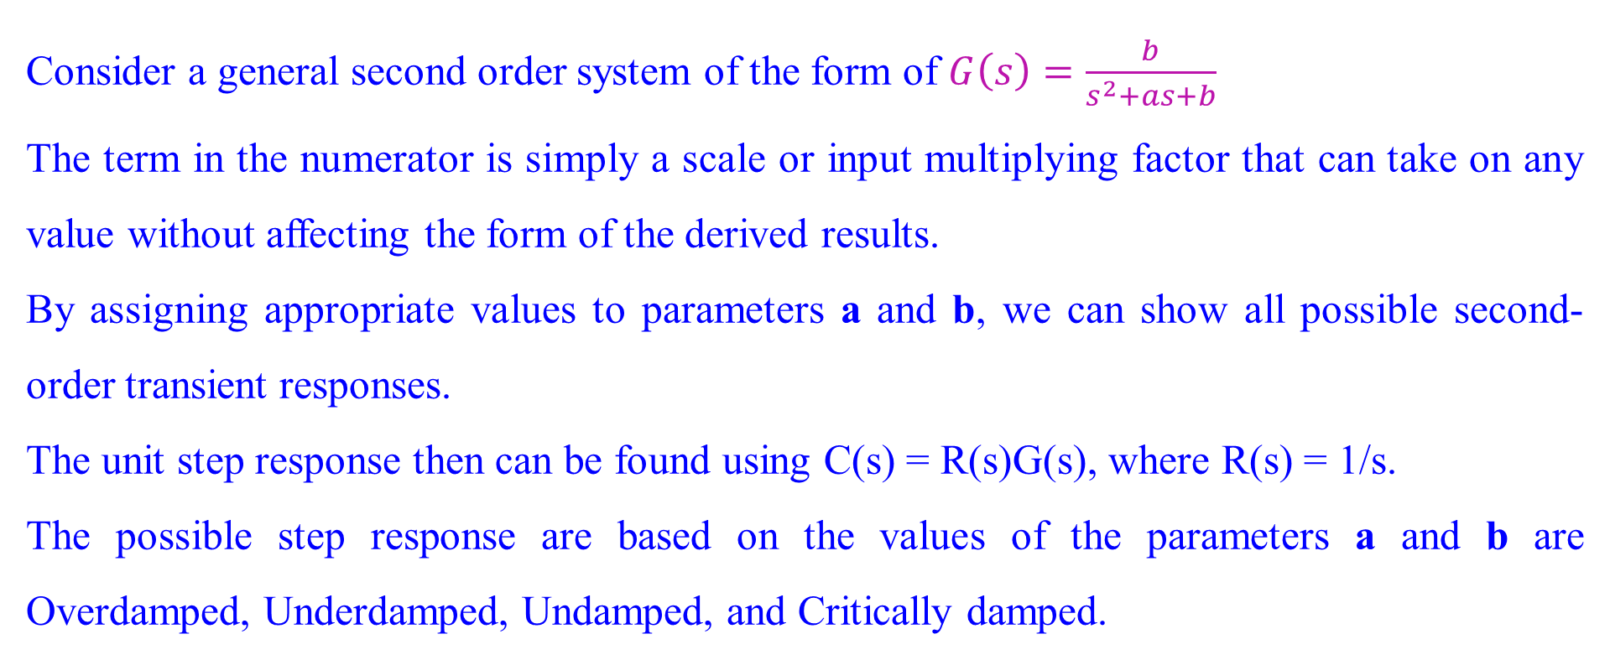
Second-Order Systems
Consider a general second order system of the form of $G\left(s\right)=\frac{b}{s^{2}+as+b}$
The term in the numerator is simply a scale or input multiplying factor that can take on any value without affecting the form of the derived results.
By assigning appropriate values to parameters a and b, we can show all possible second-order transient responses.
The unit step response then can be found using C(s) = R(s)G(s), where R(s) = 1/s.
The possible step response are based on the values of the parameters a and b are Overdamped, Underdamped, Undamped, and Critically damped.

Slide 29
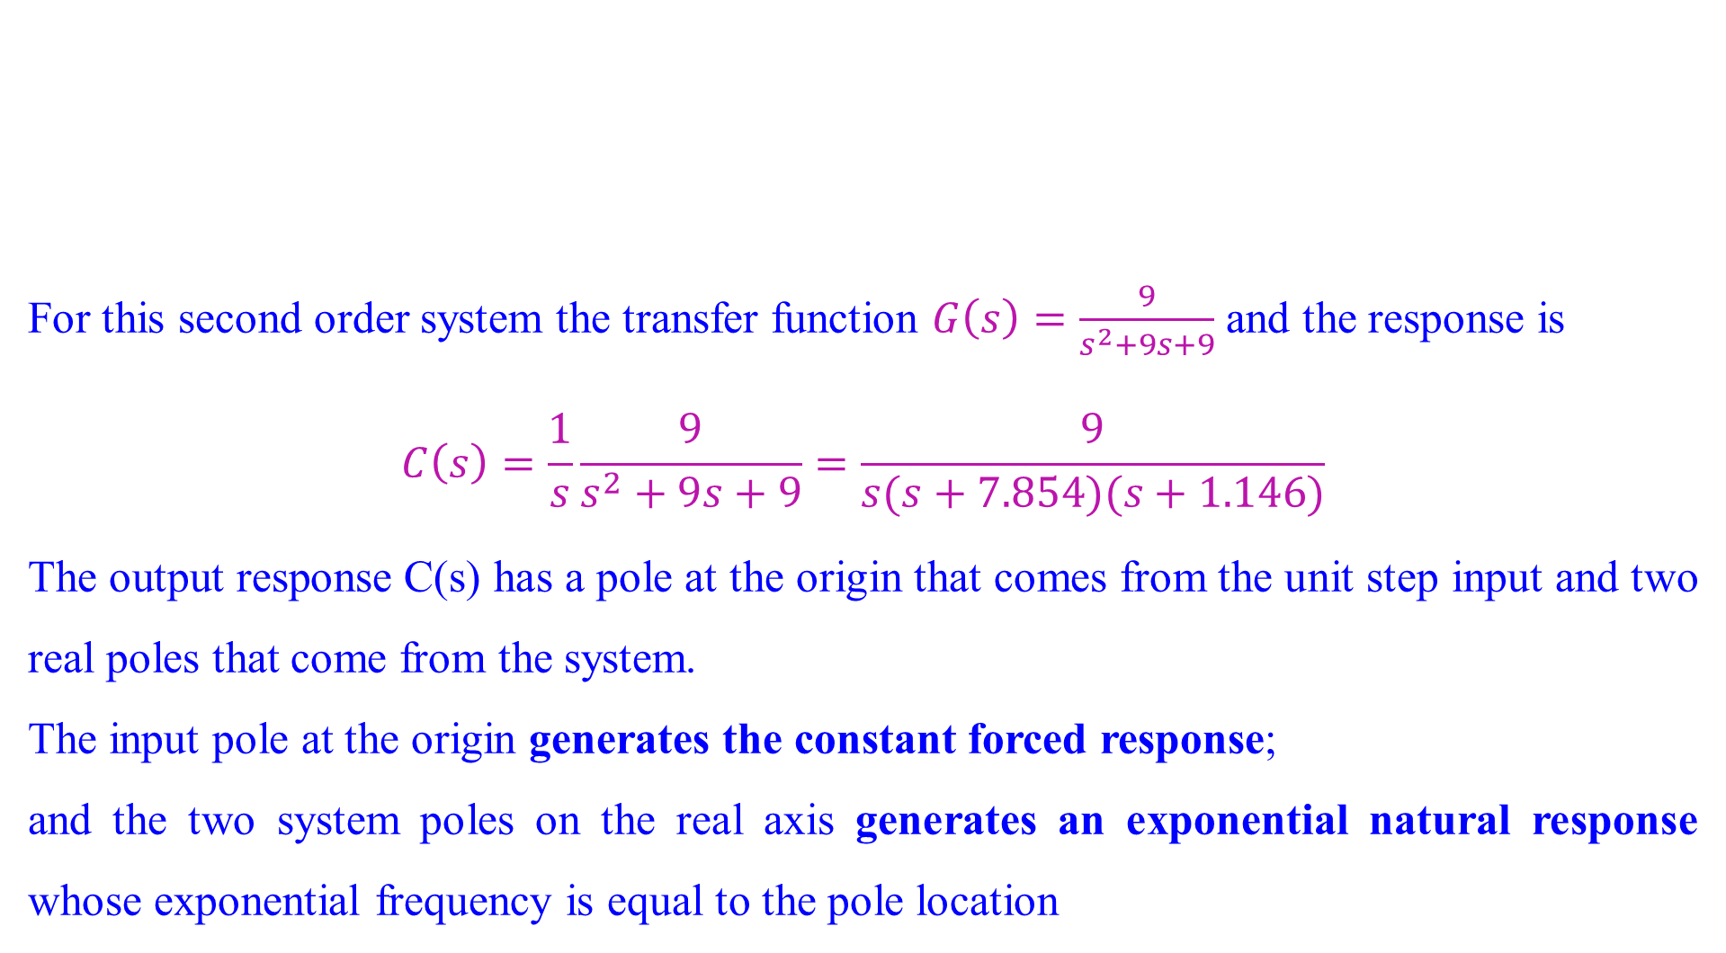
Overdamped Response
For this second order system the transfer function $G\left(s\right)=\frac{9}{s^{2}+9s+9}$ and the response is
$$C\left(s\right)=\frac{1}{s}\frac{9}{s^{2}+9s+9}=\frac{9}{s(s+7.854)(s+1.146)}$$
The output response C(s) has a pole at the origin that comes from the unit step input and two real poles that come from the system.
The input pole at the origin generates the constant forced response;
and the two system poles on the real axis generates an exponential natural response whose exponential frequency is equal to the pole location

Slide 30

Overdamped Response
The output initially could have been written as $c\left(t\right)=K_{1}+K_{2}e^{−7.854t}+K_{3}e^{−7.854t}$
This response, shown in following figure is called overdamped.
From the poles zero plot we can easily find out or visualized the nature of the response without the tedious calculation of the inverse Laplace transform.
Pole zero plot overdamped response

Slide 31
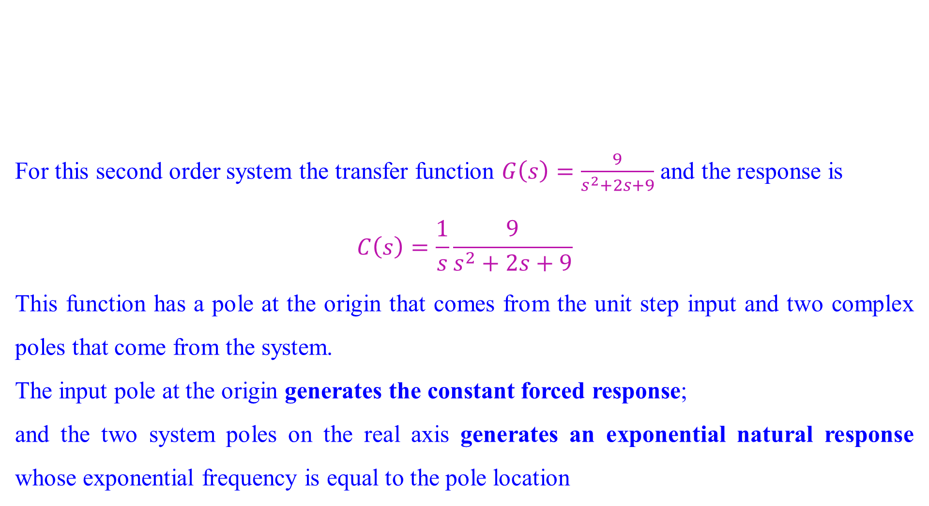
Underdamped Response
For this second order system the transfer function $G\left(s\right)=\frac{9}{s^{2}+2s+9}$ and the response is
$$C\left(s\right)=\frac{1}{s}\frac{9}{s^{2}+2s+9}$$
This function has a pole at the origin that comes from the unit step input and two complex poles that come from the system.
The input pole at the origin generates the constant forced response;
and the two system poles on the real axis generates an exponential natural response whose exponential frequency is equal to the pole location

Slide 32

Underdamped Response
Pole zero plot Underdamped response
The poles that generate the natural response are at $s=−1±j\sqrt{8}$.
The real part of the pole matches the exponential decay frequency of the sinusoid’s amplitude, while the imaginary part of the pole matches the frequency of the sinusoidal oscillation.

Slide 33
Underdamped Response
Second-order step response components generated by complex pole

Slide 34
Underdamped Response
Figure shows a general, damped sinusoidal response for a second order system.
The transient response consists of an exponentially decaying amplitude generated by the real part of the system pole times a sinusoidal waveform generated by the imaginary part of the system pole.
The time constant of the exponential decay is equal to the reciprocal of the real part of the system pole.
The value of the imaginary part is the actual frequency of the sinusoid.
This sinusoidal frequency is given the name damped frequency of oscillation, ω_{d}.
Finally, the steady-state response (unit step) was generated by the input pole located at the origin. This type of response is called as underdamped response, which approaches a steady-state value via a transient response that is a damped oscillation.

Slide 35
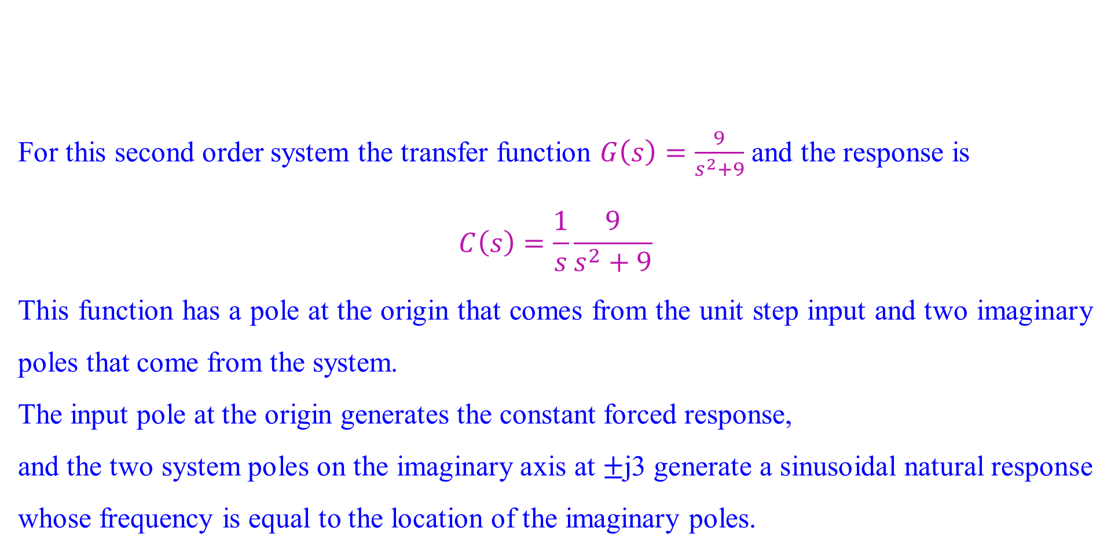
Undamped Response
For this second order system the transfer function $G\left(s\right)=\frac{9}{s^{2}+9}$ and the response is
$$C\left(s\right)=\frac{1}{s}\frac{9}{s^{2}+9}$$
This function has a pole at the origin that comes from the unit step input and two imaginary poles that come from the system.
The input pole at the origin generates the constant forced response,
and the two system poles on the imaginary axis at $±$j3 generate a sinusoidal natural response whose frequency is equal to the location of the imaginary poles.

Slide 36

Undamped Response
Hence, the output can be estimated as $c\left(t\right)=K1+K2cos⁡(3t−φ)$.
Pole zero plot undamped response
This type of response is called undamped.
Note that the absence of a real part in the pole pair corresponds to an exponential that does not decay. Mathematically, the exponential is $e^{−0t}=1$.

Slide 37
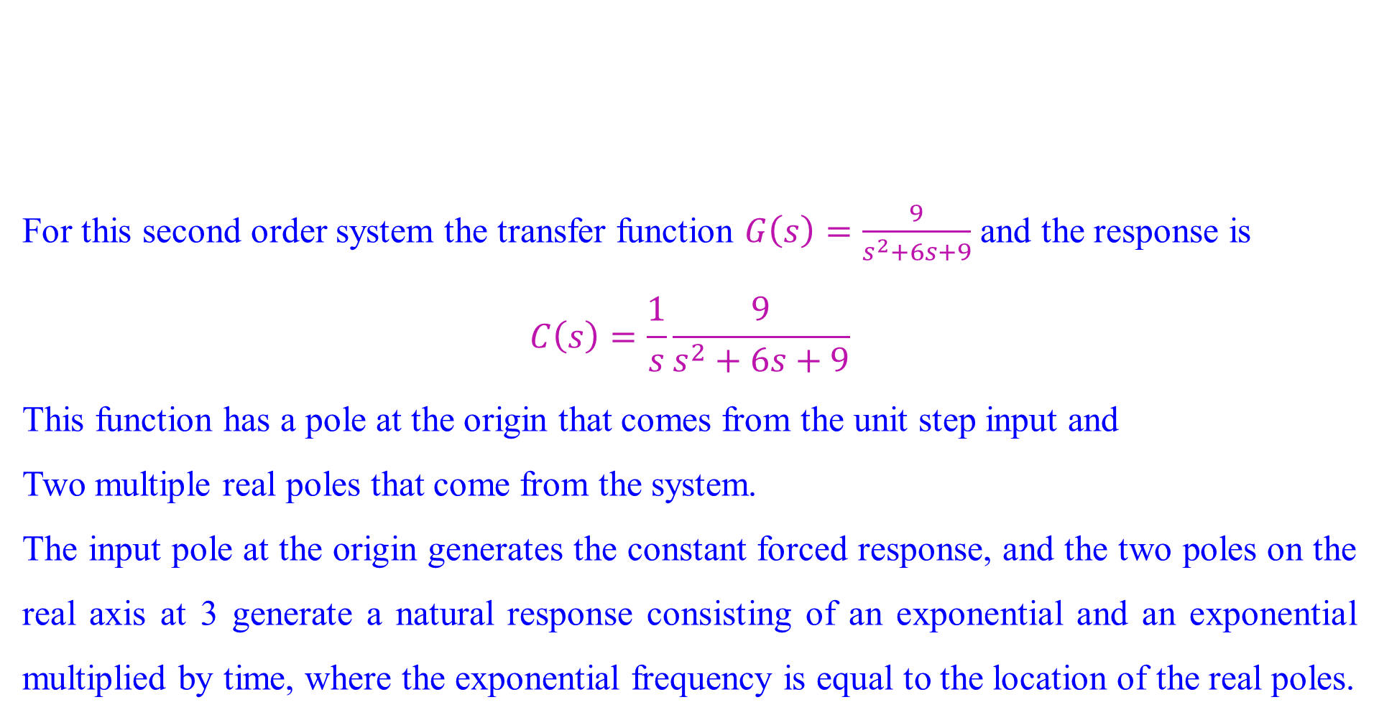
Critically damped Response
For this second order system the transfer function $G\left(s\right)=\frac{9}{s^{2}+6s+9}$ and the response is
$$C\left(s\right)=\frac{1}{s}\frac{9}{s^{2}+6s+9}$$
This function has a pole at the origin that comes from the unit step input and
Two multiple real poles that come from the system.
The input pole at the origin generates the constant forced response, and the two poles on the real axis at 3 generate a natural response consisting of an exponential and an exponential multiplied by time, where the exponential frequency is equal to the location of the real poles.

Slide 38
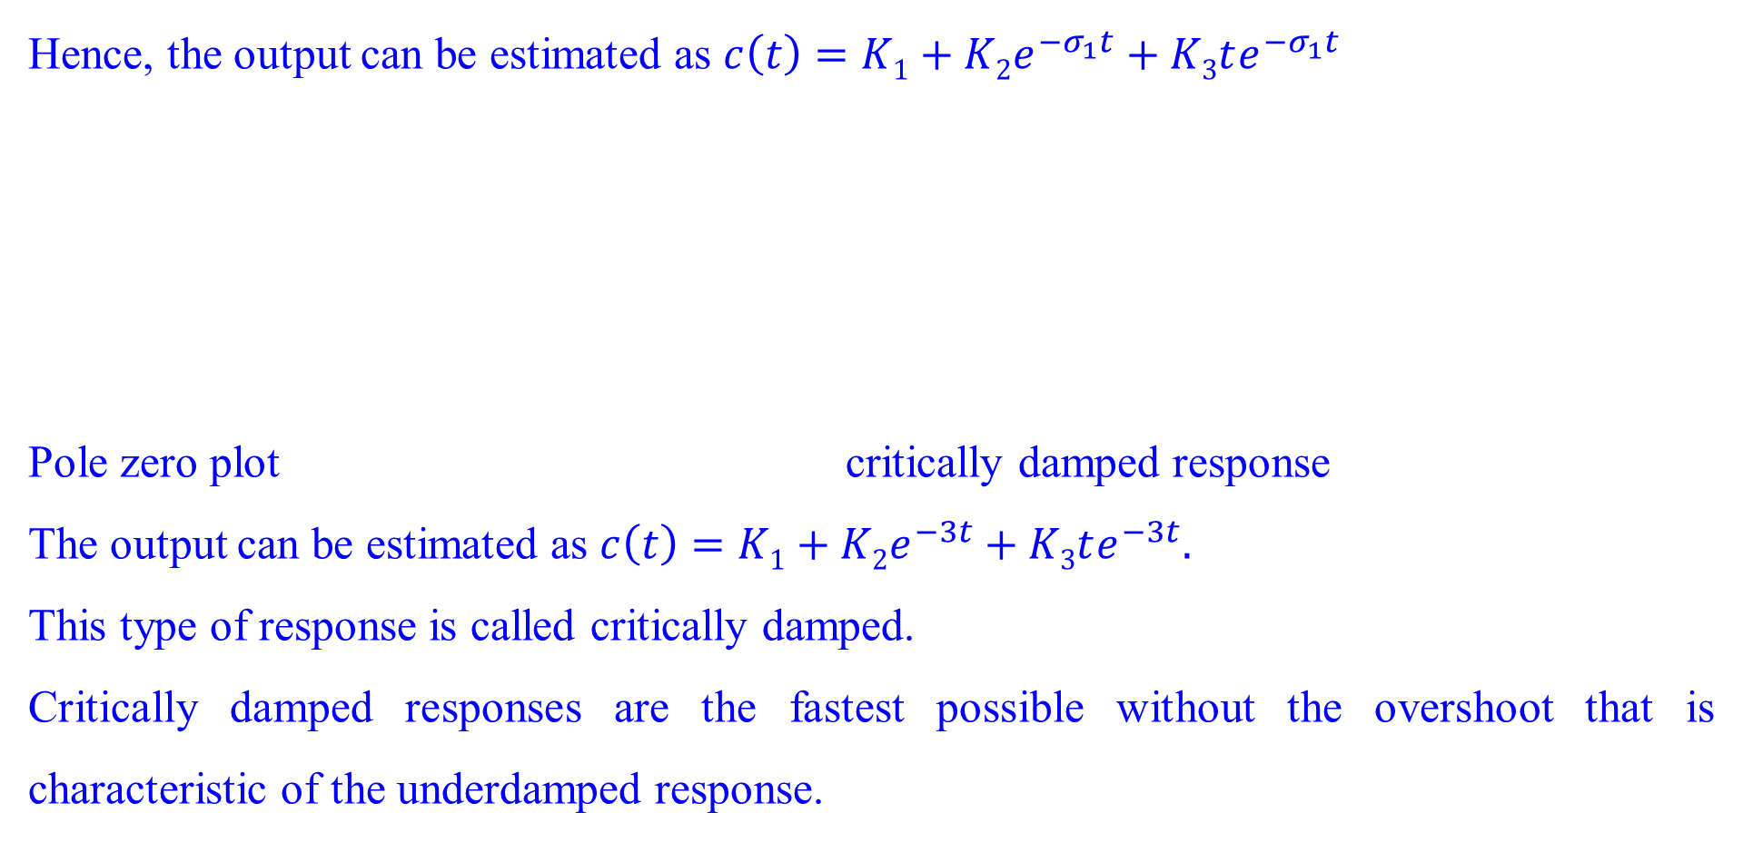
Critically damped Response
Hence, the output can be estimated as $c\left(t\right)=K1+K2e^{−σ_{1}t}+K3te^{−σ_{1}t}$
Pole zero plot critically damped response
The output can be estimated as $c\left(t\right)=K1+K2e^{−3t}+K3te^{−3t}.$
This type of response is called critically damped.
Critically damped responses are the fastest possible without the overshoot that is characteristic of the underdamped response.

Slide 39
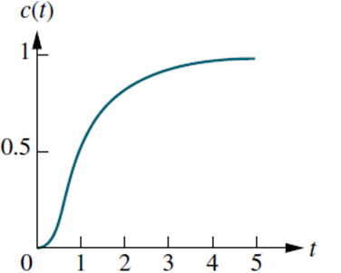
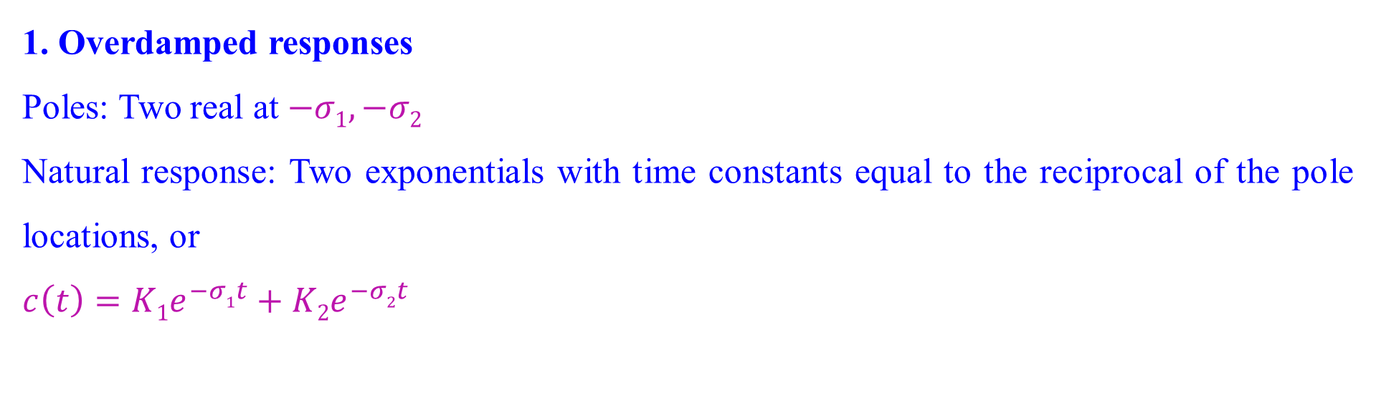
Step responses for second-order system damping cases: Conclusion
1. Overdamped responses
Poles: Two real at $−σ1,−σ2$
Natural response: Two exponentials with time constants equal to the reciprocal of the pole locations, or
$$c\left(t\right)=K1e^{−σ1t}+K2e^{−σ2t}$$

Slide 40
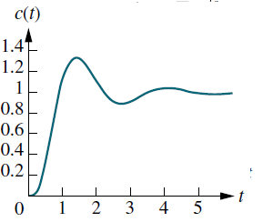
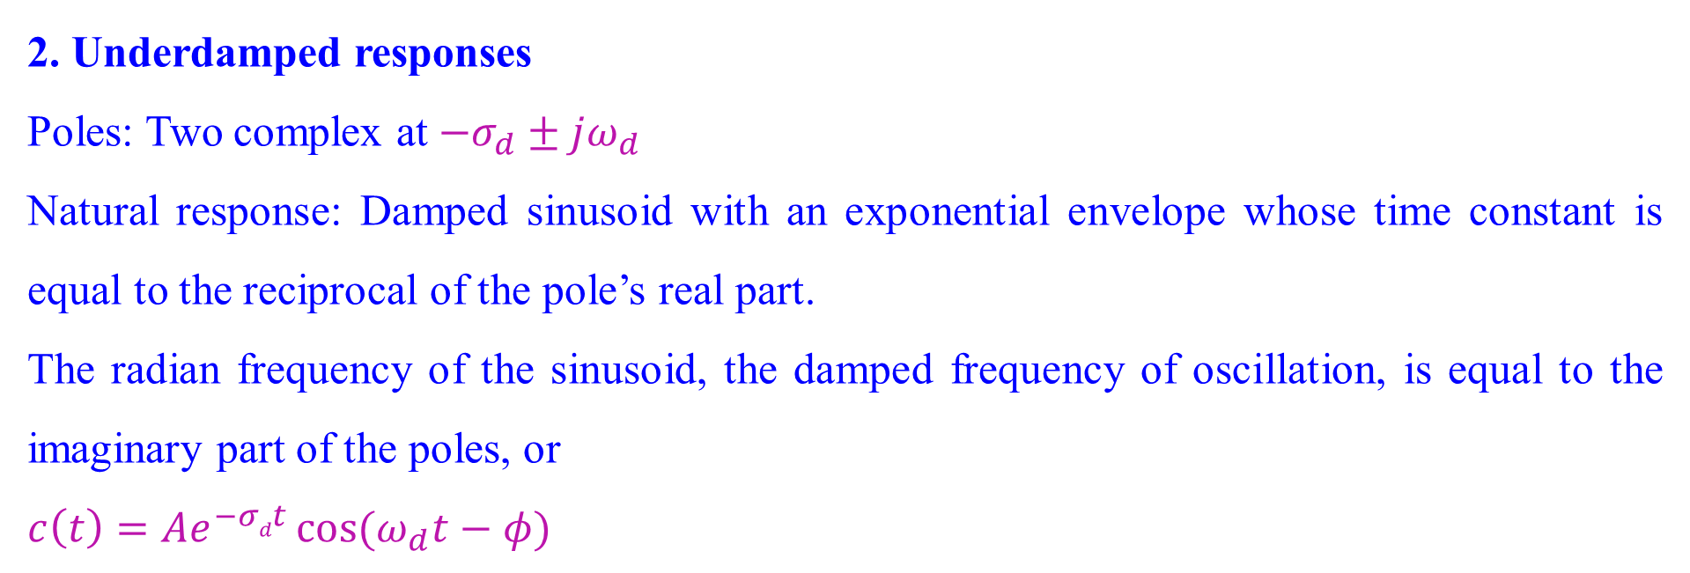
Step responses for second-order system damping cases: Conclusion
2. Underdamped responses
Poles: Two complex at ${−σ}_{d}±jω_{d}$
Natural response: Damped sinusoid with an exponential envelope whose time constant is equal to the reciprocal of the pole’s real part.
The radian frequency of the sinusoid, the damped frequency of oscillation, is equal to the imaginary part of the poles, or
$$c\left(t\right)=Ae^{−σdt}\cos{(ω_{d}t−φ)}$$

Slide 41
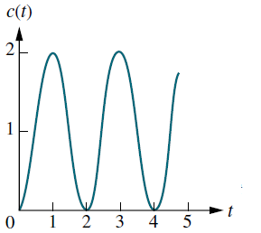
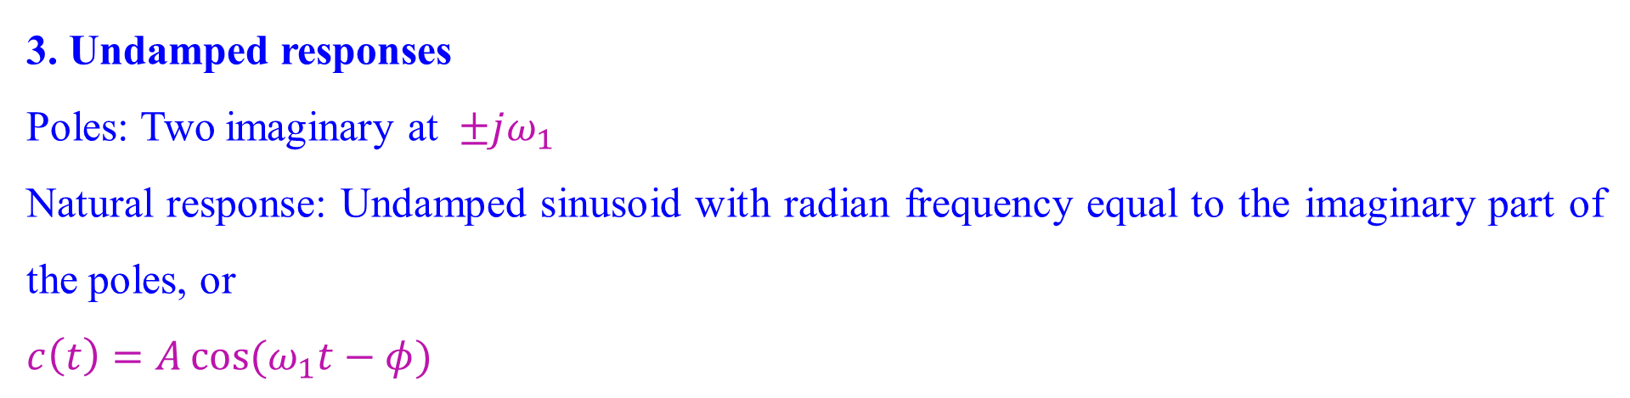
Step responses for second-order system damping cases: Conclusion
3. Undamped responses
Poles: Two imaginary at $±jω_{1}$
Natural response: Undamped sinusoid with radian frequency equal to the imaginary part of the poles, or
$$c\left(t\right)=A\cos{(ω_{1}t−φ)}$$

Slide 42
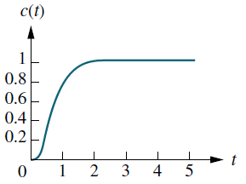
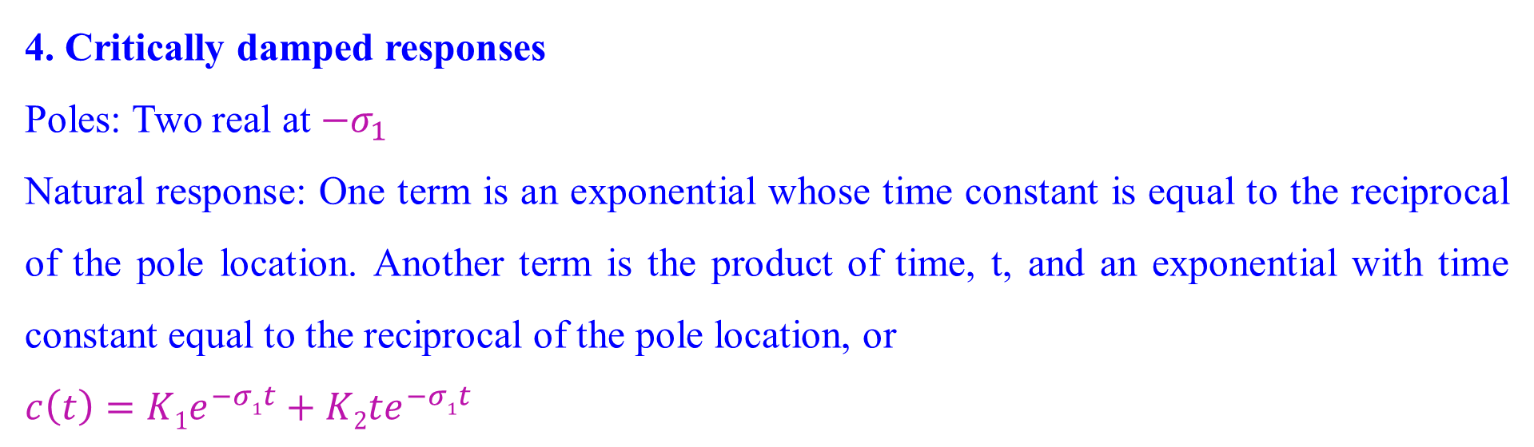
Step responses for second-order system damping cases: Conclusion
4. Critically damped responses
Poles: Two real at ${−σ}_{1}$
Natural response: One term is an exponential whose time constant is equal to the reciprocal of the pole location. Another term is the product of time, t, and an exponential with time constant equal to the reciprocal of the pole location, or
$$c\left(t\right)=K1e^{−σ1t}+K2{te}^{−σ1t}$$

Slide 43
Step responses for second-order system damping cases: Conclusion
The step responses for the four cases of damping

Slide 44
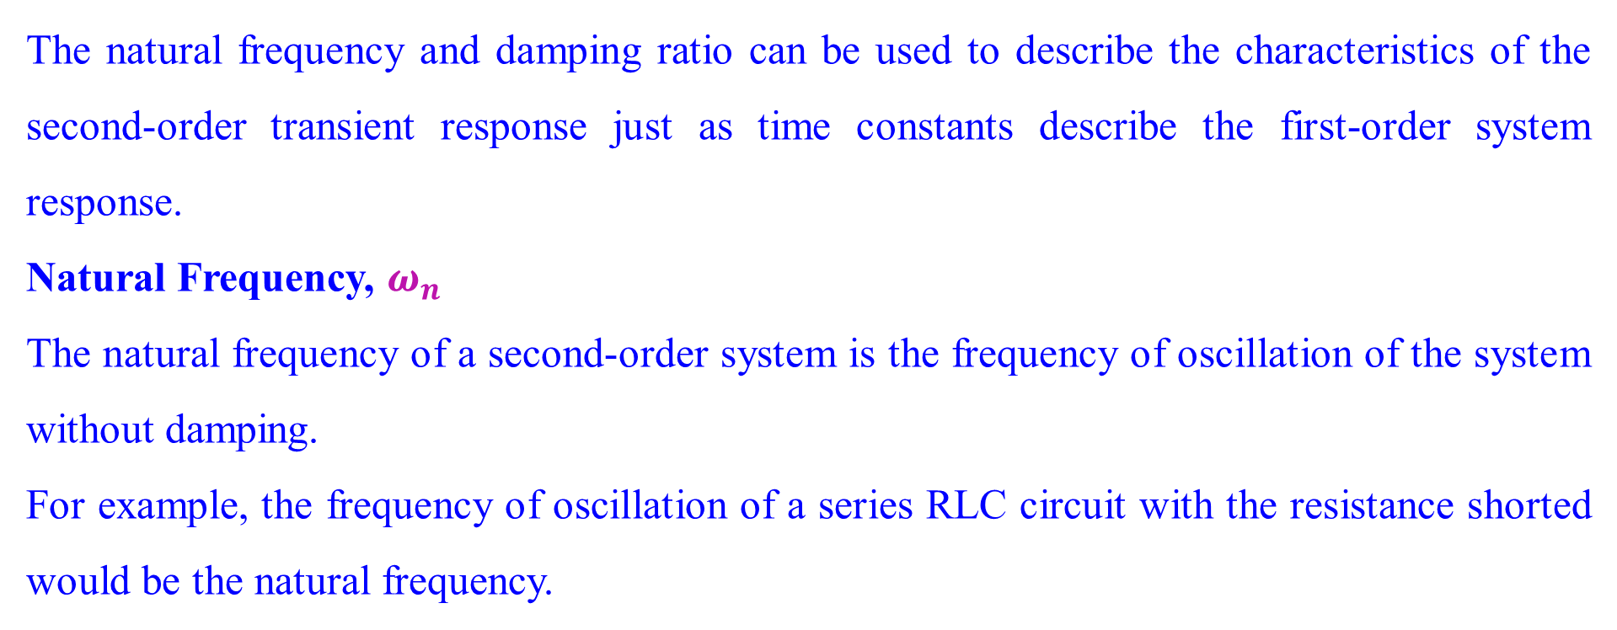
Natural frequency and Damping ratio of second order system
The natural frequency and damping ratio can be used to describe the characteristics of the second-order transient response just as time constants describe the first-order system response.
Natural Frequency, $ω_{n}$
The natural frequency of a second-order system is the frequency of oscillation of the system without damping.
For example, the frequency of oscillation of a series RLC circuit with the resistance shorted would be the natural frequency.

Slide 45
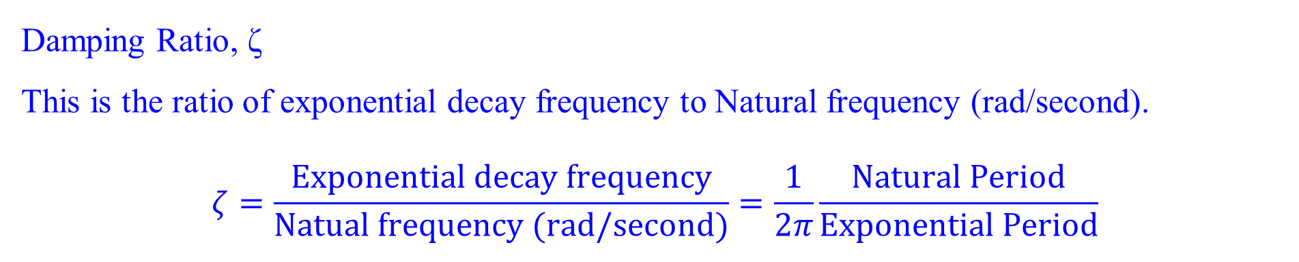
Natural frequency and Damping ratio of second order system
Damping Ratio, ζ
This is the ratio of exponential decay frequency to Natural frequency (rad/second).
$$ζ=\frac{Exponential decay frequency}{Natual frequency (rad/second)}=\frac{1}{2π}\frac{Natural Period}{Exponential Period}$$

Slide 46
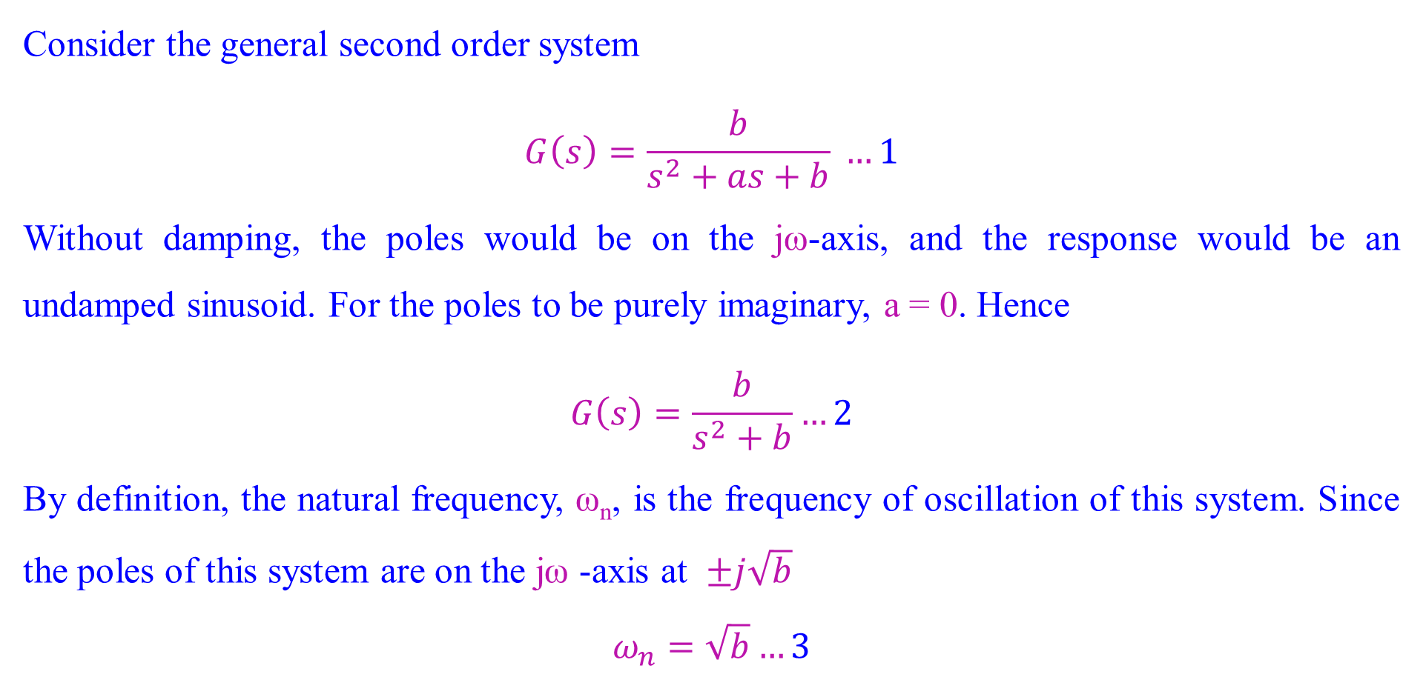
Natural frequency and Damping ratio of second order system
Consider the general second order system
$$G\left(s\right)=\frac{b}{s^{2}+as+b} …1$$
Without damping, the poles would be on the jω-axis, and the response would be an undamped sinusoid. For the poles to be purely imaginary, a = 0. Hence
$$G\left(s\right)=\frac{b}{s^{2}+b}…2$$
By definition, the natural frequency, ω_{n}, is the frequency of oscillation of this system. Since the poles of this system are on the jω -axis at $±j\sqrt{b}$
$$ω_{n}=\sqrt{b}…3$$

Slide 47
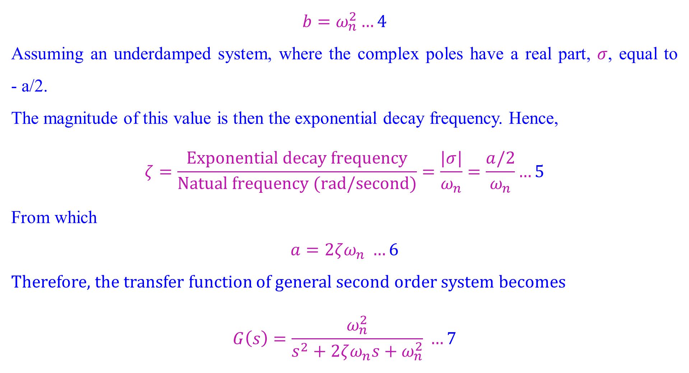
Natural frequency and Damping ratio of second order system
$$b=ω_{n}^{2}…4$$
Assuming an underdamped system, where the complex poles have a real part, $σ$, equal to - a/2.
The magnitude of this value is then the exponential decay frequency. Hence,
$$ζ=\frac{Exponential decay frequency}{Natual frequency (rad/second)}=\frac{|σ|}{ω_{n}}=\frac{a/2}{ω_{n}}…5$$
From which
$$a=2ζω_{n} …6$$
Therefore, the transfer function of general second order system becomes
$$G\left(s\right)=\frac{ω_{n}^{2}}{s^{2}+2ζω_{n}s+ω_{n}^{2}} …7$$

Slide 48
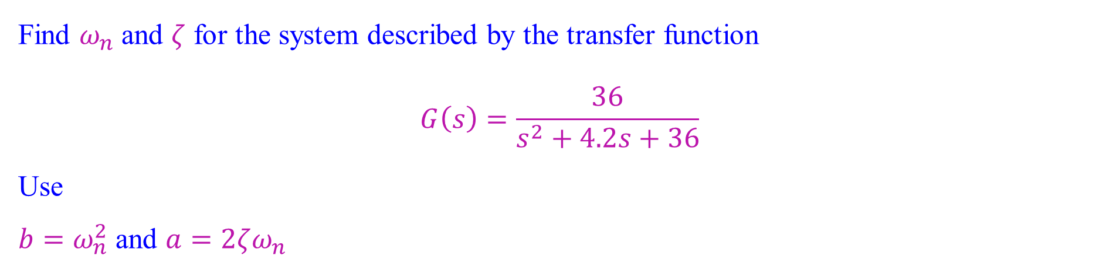
Natural frequency and Damping ratio of second order system
Find $ω_{n}$and $ζ$ for the system described by the transfer function
$$G\left(s\right)=\frac{36}{s^{2}+4.2s+36}$$
Use
$b=ω_{n}^{2}$ and $a=2ζω_{n}$

Slide 49
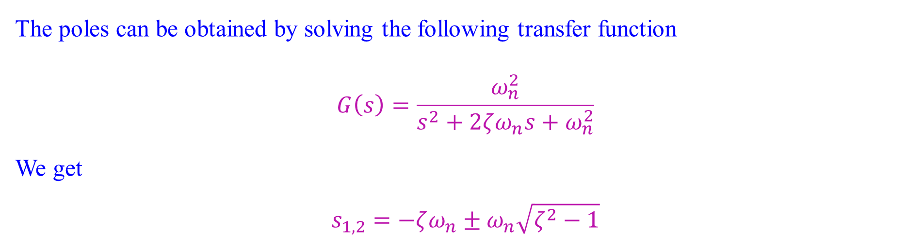
Natural frequency, Damping ratio and pole locations of second order system
The poles can be obtained by solving the following transfer function
$$G\left(s\right)=\frac{ω_{n}^{2}}{s^{2}+2ζω_{n}s+ω_{n}^{2}}$$
We get
$$s_{1,2}=−ζω_{n}±ω_{n}\sqrt{ζ^{2}−1}$$

Slide 50

Natural frequency, Damping ratio and pole locations of second order system
For $ζ=0$
Poles Step response: undamped

Slide 51

Natural frequency, Damping ratio and pole locations of second order system
For $0<ζ<1$
Poles Step response: underdamped

Slide 52

Natural frequency, Damping ratio and pole locations of second order system
For $ζ=1$
Poles Step response: critically damped

Slide 53

Natural frequency, Damping ratio and pole locations of second order system
For $ζ>1$
Poles Step response: overdamped

Slide 54

Natural frequency, Damping ratio and pole locations of second order system
For each of the systems shown, find the value of $ζ$and report the kind of response expected.
A)
B)
C)
Use $a=2 ζω_{n}$ and $ω_{n}=\sqrt{b}$ therefore $ζ=\frac{a}{2\sqrt{b}}$

Slide 55

Natural frequency, Damping ratio and pole locations of second order system
For each of the transfer functions
Find the values of $ζ$ and $ω_{n}$;
characterize the nature of the response.
$$a. G(s)=\frac{400}{s^{2}+12s+400}$$
$$b. G(s)=\frac{900}{s^{2}+90s+900}$$
$$c. G(s)=\frac{225}{s^{2}+30s+225}$$
$$d. G(s)=\frac{625}{s^{2}+625}$$

Slide 56
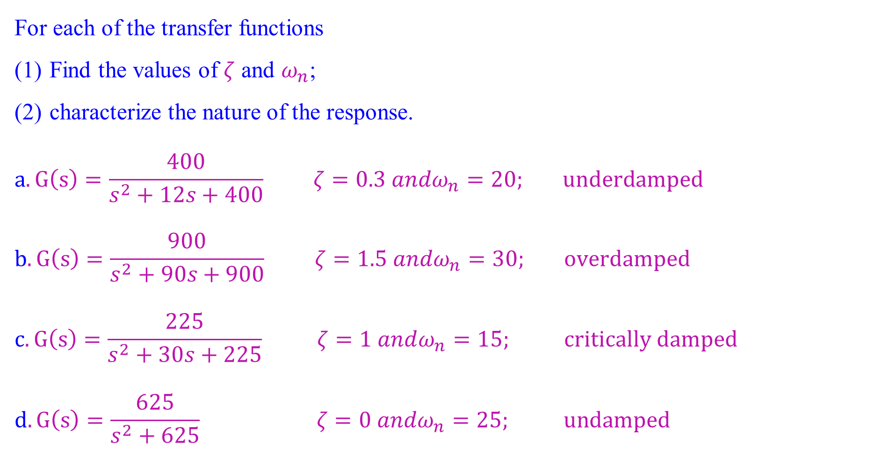
Natural frequency, Damping ratio and pole locations of second order system
For each of the transfer functions
Find the values of $ζ$ and $ω_{n}$;
characterize the nature of the response.
$$a. G\left(s\right)=\frac{400}{s^{2}+12s+400} ζ=0.3 andω_{n}=20; underdamped$$
$$b. G\left(s\right)=\frac{900}{s^{2}+90s+900} ζ=1.5 andω_{n}=30; overdamped$$
$$c. G\left(s\right)=\frac{225}{s^{2}+30s+225} ζ=1 andω_{n}=15; critically damped$$
$$d. G\left(s\right)=\frac{625}{s^{2}+625} ζ=0 andω_{n}=25; undamped$$

Slide 57
Underdamped Second-Order Systems
The underdamped second order system is a common model for physical problems.
A detailed description of the underdamped response is necessary for both analysis and design. The objectives of this study are
To define transient specifications associated with underdamped responses.
To relate these specifications to the pole location, drawing an association between pole location and the form of the underdamped second-order response.
to tie the pole location to system parameters.

Slide 58
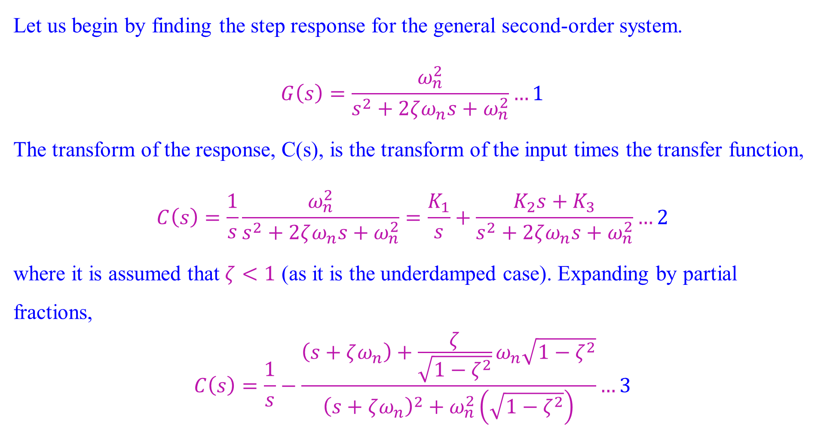
Underdamped Second-Order Systems
Let us begin by finding the step response for the general second-order system.
$$G\left(s\right)=\frac{ω_{n}^{2}}{s^{2}+2ζω_{n}s+ω_{n}^{2}}…1$$
The transform of the response, C(s), is the transform of the input times the transfer function,
$$C\left(s\right)=\frac{1}{s}\frac{ω_{n}^{2}}{s^{2}+2ζω_{n}s+ω_{n}^{2}}=\frac{K_{1}}{s}+\frac{K_{2}s+K_{3}}{s^{2}+2ζω_{n}s+ω_{n}^{2}}…2$$
where it is assumed that $ζ<1$ (as it is the underdamped case). Expanding by partial
fractions,
$$C\left(s\right)=\frac{1}{s}−\frac{\left(s+ζω_{n}\right)+\frac{ζ}{\sqrt{1−ζ^{2}}}ω_{n}\sqrt{1−ζ^{2}}}{{\left(s+ζω_{n}\right)}^{2}+ω_{n}^{2}\left(\sqrt{1−ζ^{2}}\right)}…3$$

Slide 59

Underdamped Second-Order Systems
Taking the inverse Laplace transform
$$c\left(t\right)=1−e^{−ζω_{n}t}\left(\cos{ω_{n}\sqrt{1−ζ^{2}}}t+\frac{ζ}{\sqrt{1−ζ^{2}}}\sin{ω_{n}\sqrt{1−ζ^{2}}}t\right)…4$$
$$=1−\frac{e^{−ζω_{n}t}}{\sqrt{1−ζ^{2}}}\sin\left(ω_{n}\sqrt{1−ζ^{2}}t+φ\right)…5$$
where $φ=\tan^{−1}\left(\sqrt{1−ζ^{2}}/ζ\right)…6$

Slide 60
Underdamped Second-Order Systems
Second-order underdamped responses for damping ratio $(ζ)$ values

Slide 61
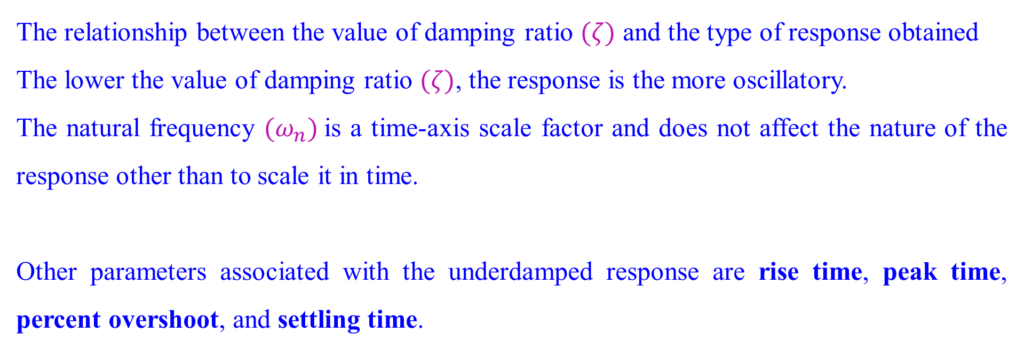
Underdamped Second-Order Systems
The relationship between the value of damping ratio $(ζ)$ and the type of response obtained
The lower the value of damping ratio $(ζ)$, the response is the more oscillatory.
The natural frequency ${(ω}_{n})$is a time-axis scale factor and does not affect the nature of the response other than to scale it in time.
Other parameters associated with the underdamped response are rise time, peak time, percent overshoot, and settling time.

Slide 62
Underdamped Second-Order Systems
Second-order underdamped response specifications

Slide 63
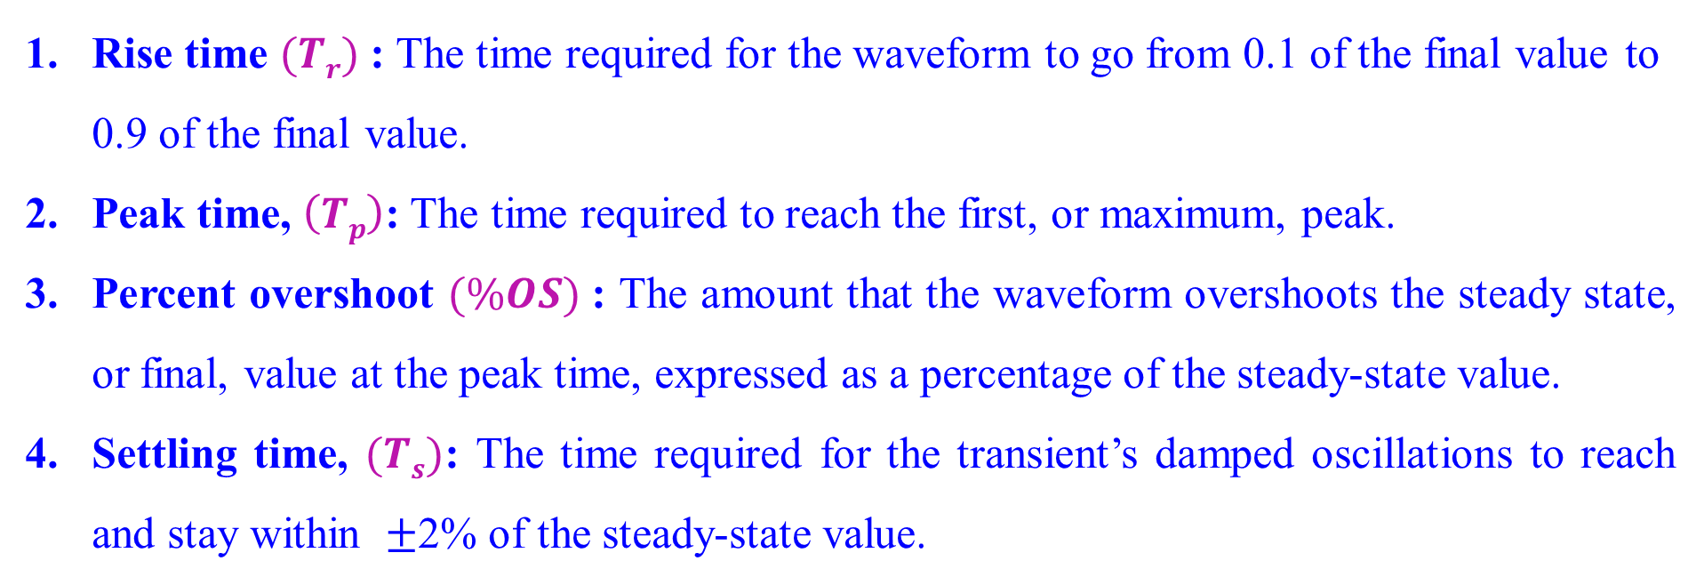
Underdamped Second-Order Systems
Rise time $(Tr)$: The time required for the waveform to go from 0.1 of the final value to 0.9 of the final value.
Peak time, $\left(Tp\right)$: The time required to reach the first, or maximum, peak.
Percent overshoot $(\%OS)$: The amount that the waveform overshoots the steady state, or final, value at the peak time, expressed as a percentage of the steady-state value.
Settling time, $(Ts)$: The time required for the transient’s damped oscillations to reach and stay within $±$2% of the steady-state value.

Slide 64
Underdamped Second-Order Systems
The definitions for settling time and rise time are basically the same as the definitions for the first-order response.
All definitions are also valid for systems of order higher than 2, although analytical expressions for these parameters cannot be found unless the response of the higher-order system can be approximated as a second-order system.

Slide 65
Underdamped Second-Order Systems
Rise time, peak time, and settling time yield information about the speed of the transient response. This information can help a designer determine if the speed and the nature of the response do or do not degrade the performance of the system.
For example, the speed of an entire computer system depends on the time it takes for a hard drive head to reach steady state and read data;
passenger comfort depends in part on the suspension system of a car and the number of oscillations it goes through after hitting a bump.

Slide 66
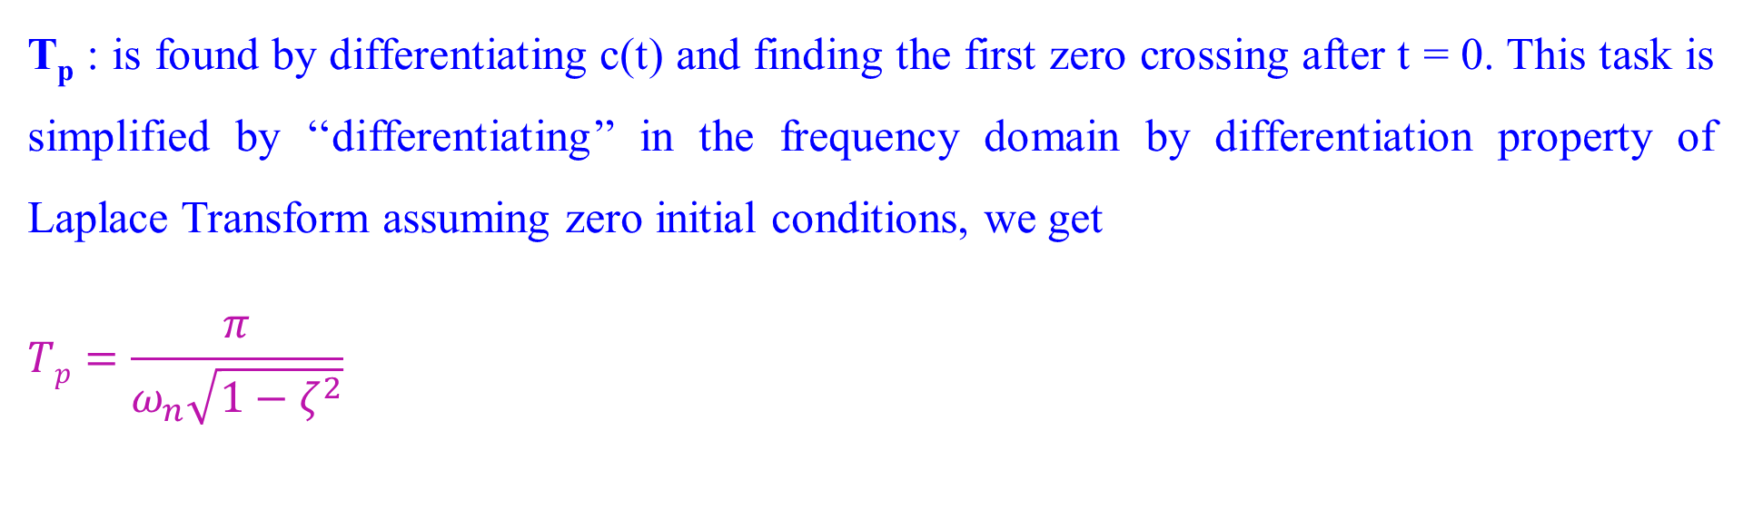
Underdamped Second-Order Systems: Evaluation of T_{p}
T_{p} : is found by differentiating c(t) and finding the first zero crossing after t = 0. This task is simplified by ‘‘differentiating’’ in the frequency domain by differentiation property of Laplace Transform assuming zero initial conditions, we get
$$Tp=\frac{π}{ω_{n}\sqrt{1−ζ^{2}}}$$

Slide 67
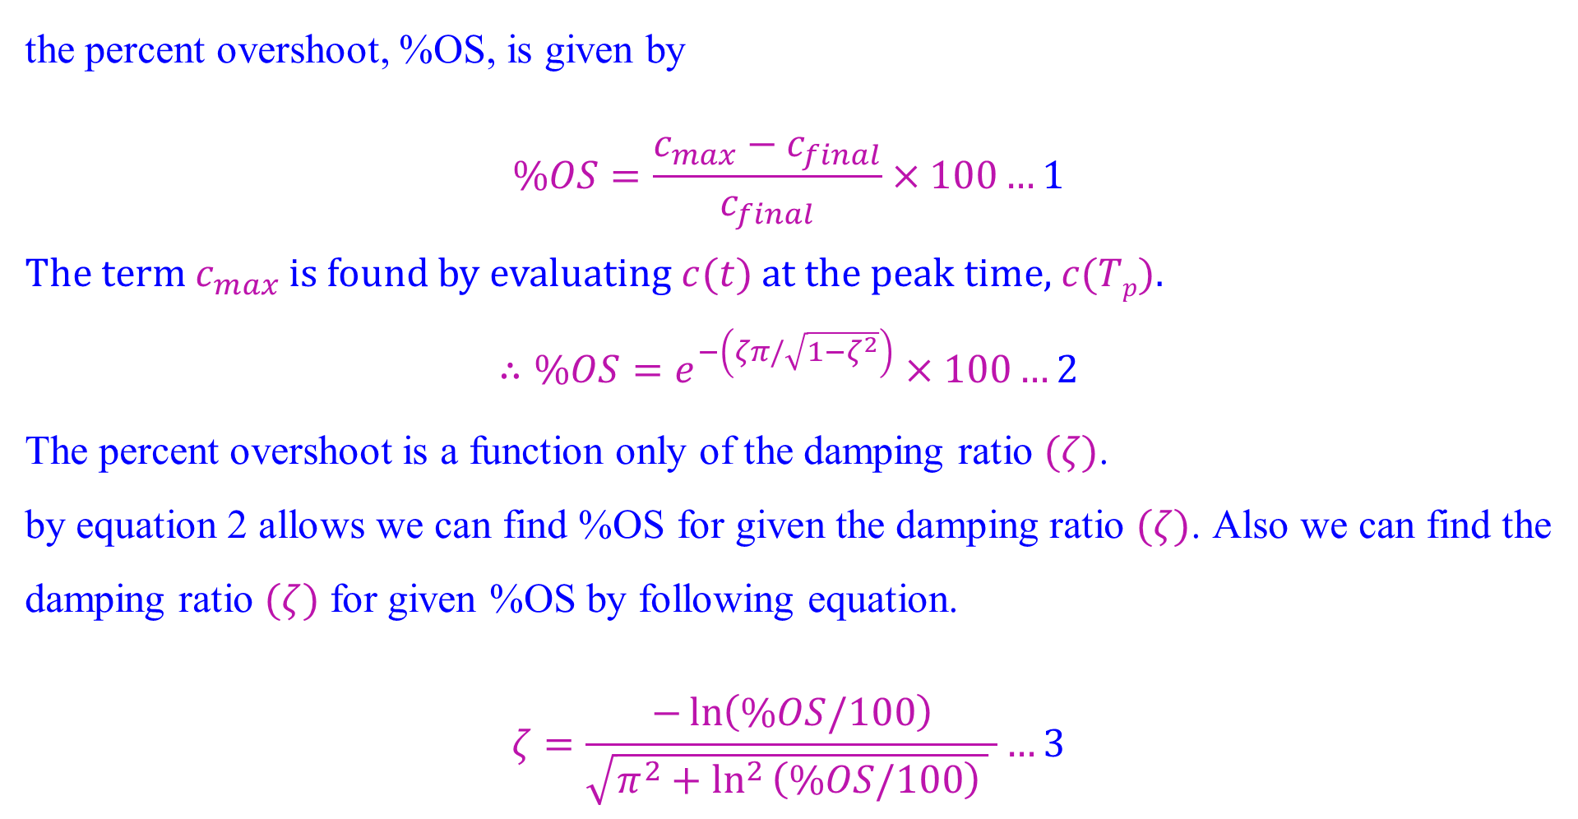
Underdamped Second-Order Systems: Evaluation of %OS
the percent overshoot, %OS, is given by
$$\%OS=\frac{c_{max}−c_{final}}{c_{final}}×100…1$$
The term $c_{max}$ is found by evaluating $c(t)$ at the peak time, $c(Tp)$.
$$∴\%OS=e^{−\left(ζπ/\sqrt{1−ζ^{2}}\right)}×100…2$$
The percent overshoot is a function only of the damping ratio $(ζ)$.
by equation 2 allows we can find %OS for given the damping ratio $(ζ)$. Also we can find the damping ratio $(ζ)$ for given %OS by following equation.
$$ζ=\frac{−\ln\left(\%OS/100\right)}{\sqrt{π^{2}+\ln^{2 }\left(\%OS/100\right) } }…3$$

Slide 68
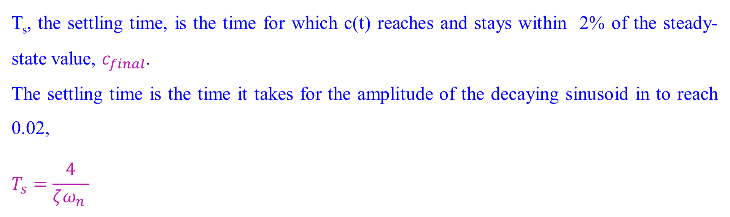
Underdamped Second-Order Systems: Evaluation of T_{s}
T_{s}, the settling time, is the time for which c(t) reaches and stays within 2% of the steady-state value, $c_{final}$.
The settling time is the time it takes for the amplitude of the decaying sinusoid in to reach 0.02,
$$T_{s}=\frac{4}{ζω_{n} }$$

Slide 69
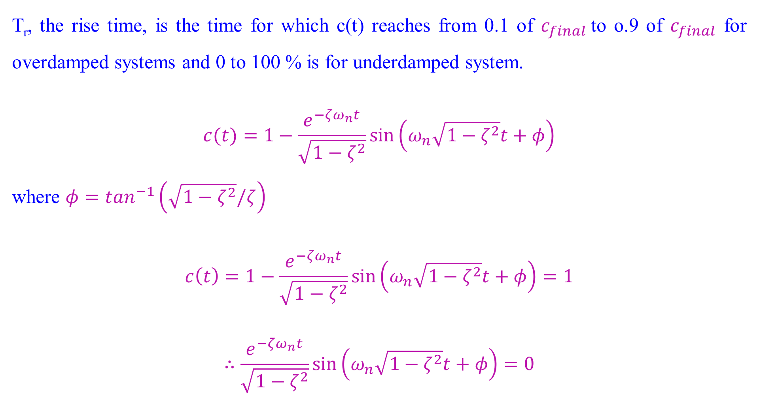
Underdamped Second-Order Systems: Evaluation of T_{r}
T_{r}, the rise time, is the time for which c(t) reaches from 0.1 of $c_{final}$to o.9 of $c_{final}$ for overdamped systems and 0 to 100 % is for underdamped system.
$$c(t)=1−\frac{e^{−ζω_{n}t}}{\sqrt{1−ζ^{2}}}\sin\left(ω_{n}\sqrt{1−ζ^{2}}t+φ\right)$$
where $φ=\tan^{−1}\left(\sqrt{1−ζ^{2}}/ζ\right)$
$$c\left(t\right)=1−\frac{e^{−ζω_{n}t}}{\sqrt{1−ζ^{2}}}\sin\left(ω_{n}\sqrt{1−ζ^{2}}t+φ\right)=1$$
$$∴\frac{e^{−ζω_{n}t}}{\sqrt{1−ζ^{2}}}\sin\left(ω_{n}\sqrt{1−ζ^{2}}t+φ\right)=0$$

Slide 70
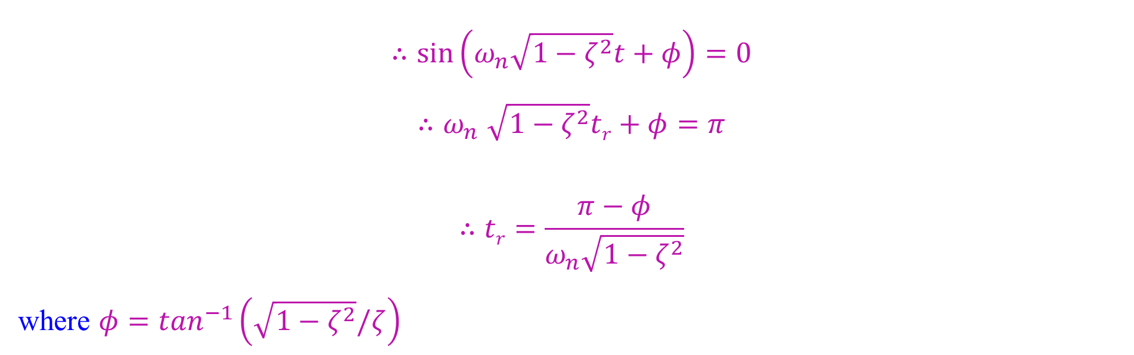
Underdamped Second-Order Systems: Evaluation of T_{r}
$$∴\sin\left(ω_{n}\sqrt{1−ζ^{2}}t+φ\right)=0$$
$${∴ω}_{n}\sqrt{1−ζ^{2}}tr+φ=π$$
$$∴tr=\frac{π−φ}{ω_{n}\sqrt{1−ζ^{2}}}$$
where $φ=\tan^{−1}\left(\sqrt{1−ζ^{2}}/ζ\right)$

Slide 71

Underdamped Second-Order Systems:
Find the find T_{p}, %OS, T_{s}, and T_{r} For the system described by the transfer function
$$G(s)=\frac{100}{s^{2}+15s+100}$$

Slide 72

Underdamped Second-Order Systems:
Find the find T_{p}, %OS, T_{s}, and T_{r} For the system described by the transfer function
$$G(s)=\frac{100}{s^{2}+15s+100}$$
$ζ=0.75$, $ω_{n}=10$
$$Tp=\frac{π}{ω_{n}\sqrt{1−ζ^{2}}}=0.475 second$$
$$\%OS=e^{−\left(ζπ/\sqrt{1−ζ^{2}}\right)}×100=2.838$$
$$T_{s}=\frac{4}{ζω_{n} }=0.533 second$$
$$Tr=\frac{π−φ}{ω_{n}\sqrt{1−ζ^{2}}}=0.23 second$$

Slide 73

Underdamped Second-Order Systems:
The pole plot for a general, underdamped second-order system, shown in Figure.
We see from the Pythagorean theorem that the radial distance from the origin to the pole is the natural frequency $ω_{n}$ and the $cos θ=ζ$.
$$Tp=\frac{π}{ω_{n}\sqrt{1−ζ^{2}}}=\frac{π}{ω_{d}}…1$$
$$T_{s}=\frac{4}{ζω_{n} }=\frac{4}{σ_{d} }…2$$
Pole plot for general underdamped second order system

Slide 74

Underdamped Second-Order Systems:
$$Tp=\frac{π}{ω_{n}\sqrt{1−ζ^{2}}}=\frac{π}{ω_{d}}…1$$
$$T_{s}=\frac{4}{ζω_{n} }=\frac{4}{σ_{d} }…2$$
where $ω_{d}$ is the imaginary part of the pole and is called the damped frequency of oscillation, and
$σ_{d}$ is the magnitude of the real part of the pole and is the exponential damping frequency.

Slide 75

Underdamped Second-Order Systems:
$$Tp=\frac{π}{ω_{n}\sqrt{1−ζ^{2}}}=\frac{π}{ω_{d}}…1$$
$$T_{s}=\frac{4}{ζω_{n} }=\frac{4}{σ_{d} }…2$$
Equation (1) shows that $Tp$ is inversely proportional to the imaginary part of the pole.
Since horizontal lines on the s-plane are lines of constant imaginary value, they are also lines of constant peak time.
Similarly, Eq. (2) tells us that $Ts$ settling time is inversely proportional to the real part of the pole.
Since vertical lines on the s-plane are lines of constant real value, they are also lines of constant settling time.

Slide 76

Underdamped Second-Order Systems:
Finally, since $ζ=\cos{θ}$, radial lines are lines of constant $ζ$. Since percent overshoot is only a function of $ζ$, radial lines are thus lines of constant percent overshoot, %OS.
The lines of constant Tp, Ts, and %OS are labeled on the s-plane.
Lines of constant peak time, T_{p}, settling time, T_{s}, and percent overshoot, %OS. Note: T_{s2} < T_{s1} ;
T_{p2} < T_{p1};
%OS1 < %OS2

Slide 77
Underdamped Second-Order Systems:
the poles are moved in a vertical direction, keeping the real part the same.
As the poles move in a vertical direction, the frequency increases, but the envelope remains the same since the real part of the pole is not changing.

Slide 78
Underdamped Second-Order Systems:
Figure shows the step responses as the poles are moved in a vertical direction, keeping the real part the same.
As the poles move in a vertical direction, the frequency increases, but the envelope remains the same since the real part of the pole is not changing.
The figure shows a constant exponential envelope, even though the sinusoidal response is
changing frequency.
Since all curves fit under the same exponential decay curve, the settling time is virtually the same for all waveforms. Note that as overshoot increases, the rise time decreases

Slide 79
Underdamped Second-Order Systems:
the poles are moved in a horizontal direction, keeping the imaginary part the same.
As the poles move to the left, the response damps out more rapidly, while the frequency remains the same.
the peak time is the same for all waveforms because the imaginary part remains the same.

Slide 80
Underdamped Second-Order Systems:
Now move the poles to the right or left.
Since the imaginary part is now constant, movement of the poles yields the responses of as shown in figure.
Here the frequency is constant over the range of variation of the real part.
As the poles move to the left, the response damps out more rapidly, while the frequency remains the same.
Notice that the peak time is the same for all waveforms because the imaginary part remains the same.

Slide 81
Underdamped Second-Order Systems:
the poles are moved in a along a constant radial line.
The responses look exactly alike, except for their speed.
The farther the poles are from the origin, the more rapid the response.

Slide 82
Underdamped Second-Order Systems:
Now move the poles along a constant radial line yields the responses shown in figure.
Here the percent overshoot remains the same.
Notice also that the responses look exactly alike, except for their speed.
The farther the poles are from the origin, the more rapid the response.

Slide 83
Underdamped Second-Order Systems:
For the given the pole plot, find $ζ,ω_{n}, Tp, \%OS and Ts.$

Slide 84

Underdamped Second-Order Systems:
The damping ratio is given by $ζ=\cos{θ}=0.394$.
The natural frequency, $ω_{n}$, is the radial distance from the origin to the pole, or $ω_{n}=\sqrt{7^{2}+3^{2}}=7.616$
The peak time is
$$T_{p}=\frac{π}{ω_{d}}=\frac{π}{7}=0.449 seconds$$
The percent overshoot is
$$\%OS=e^{−\left(ζπ/\sqrt{1−ζ^{2}}\right)}×100=26\%$$
The approximate settling time is
$$T_{s}=\frac{4}{σ_{d}}=\frac{4}{3}=1.333 seconds$$

Slide 85

Underdamped Second-Order Systems:
Find $ζ,ω_{n}, Ts, Tp, Tr and \%Os$ for a system whose transfer function is
$$G\left(s\right)=\frac{361}{s^{2}+16s+361}$$

Slide 86

Underdamped Second-Order Systems:
Find $ζ,ω_{n}, Ts, Tp, Tr and \%Os$ for a system whose transfer function is
$$G\left(s\right)=\frac{361}{s^{2}+16s+361}$$
$$ζ=0.421,ω_{n}=19, Ts=0.5 s, Tp=0.182 s, Tr=0.079 s, and \%OS=23.3\%$$

Slide 87

Underdamped Second-Order Systems:
Find $ζ,ω_{n}, Ts, Tp, Tr and \%Os$ for a system whose transfer function is
$$G\left(s\right)=\frac{361}{s^{2}+16s+361}$$
$$ζ=0.421,ω_{n}=19, Ts=0.5 s, Tp=0.182 s, Tr=0.079 s, and \%OS=23.3\%$$

Slide 88

System Response with Additional Poles
Consider a three-pole system with complex poles and a third pole on the real axis.
Assuming that the complex poles are at $s_{1,2}=−ζω_{n}±ω_{n}\sqrt{{1−ζ}^{2}}$ the real pole is at $α_{r}$, the step response of the system can be determined from a partial-fraction expansion. Thus, the output transform is
$$C\left(s\right)=\frac{A}{s}+\frac{B\left(s+ζω_{n}\right)+Cω_{d}}{{(s+ζω_{n})}^{2}+ω_{d}^{2}}+\frac{D}{s+α_{r}}…1$$
And the output response is
$$c\left(t\right)=Au\left(t\right)+e^{−ζω_{n}t}\left(B\cos{ω_{d}t+}C\sin{ω_{d}t}\right)+De^{−α_{r}t}…2$$
Consider the three cases of $α_{r}$.
Case I, $α_{r}=α_{r1}$ and is not much larger than $ζω_{n}$; for Case II, $α_{r}=α_{r2}$ and is much
larger than $ζω_{n}$; and for Case III, $α_{r}=∞$.

Slide 89

System Response with Additional Poles
Case I, $α_{r}=α_{r1}$ and is not much larger than $ζω_{n}$
The real pole’s transient response will not decay to insignificance at the peak time or settling time generated by the second-order pair.
In this case, the exponential decay is significant, and the system cannot be represented as a second-order system.

Slide 90

System Response with Additional Poles
Case II, $α_{r}=α_{r2}$ and is much larger than $ζω_{n}$and
Case III, $α_{r}=∞$
The pure exponential will die out much more rapidly than the second-order underdamped step response.
If the pure exponential term decays to an insignificant value at the time of the first overshoot, such parameters as percent overshoot, settling time, and peak time will be generated by the second-order underdamped step response component.
Thus, the total response will approach that of a pure second-order system.

Slide 91

System Response with Additional Poles
component responses: Nondominant pole is near dominant second-order pair (Case I),
Far from the pair (Case II), and
at infinity (Case III).

Slide 92

System Response with Additional Poles
In a three-pole system with dominant second-order poles and no zeros, will actually decrease in magnitude as the third pole is moved farther into the left half-plane.
Assume a step response, C(s), of a three-pole system
$$C\left(s\right)=\frac{bc}{s{(s}^{2}+as+b)(s+c)}=\frac{A}{s}+\frac{Bs+C}{{(s}^{2}+as+b)}+\frac{D}{s+c}$$
here we assume that the nondominant pole is located at c on the real axis and that the steady-state response approaches unity. Evaluating the constants in the numerator of each term
$$A=1; B=\frac{ca−c^{2}}{c^{2}+b−ca}; C=\frac{{ca}^{2}−c^{2}a−bc}{c^{2}+b−ca}; and D=\frac{−b}{c^{2}+b−ca}$$

Slide 93
System Response with Additional Poles
In a three-pole system with dominant second-order poles and no zeros, will actually decrease in magnitude as the third pole is moved farther into the left half-plane.
Assume a step response, C(s), of a three-pole system
$$C\left(s\right)=\frac{bc}{s{(s}^{2}+as+b)(s+c)}=\frac{A}{s}+\frac{Bs+C}{{(s}^{2}+as+b)}+\frac{D}{s+c}$$
here we assume that the nondominant pole is located at c on the real axis and that the steady-state response approaches unity. Evaluating the constants in the numerator of each term
$$A=1; B=\frac{ca−c^{2}}{c^{2}+b−ca}; C=\frac{{ca}^{2}−c^{2}a−bc}{c^{2}+b−ca}; and D=\frac{−b}{c^{2}+b−ca}$$

Slide 94

System Response with Additional Poles
$$A=1; B=\frac{ca−c^{2}}{c^{2}+b−ca}; C=\frac{{ca}^{2}−c^{2}a−bc}{c^{2}+b−ca}; and D=\frac{−b}{c^{2}+b−ca}$$
As the nondominant pole approaches $∞$; or $c→∞,$
$$A=1;B=−1;C=−a;and D=0.$$
Thus, for this example, D, the residue of the nondominant pole and its response, becomes zero as the nondominant pole approaches infinity.

Slide 95

System Response with Zero
We know that the zeros of a response affect the residue, or amplitude, of a response component but do not affect the nature of the response - exponential, damped sinusoid.
The zero will be added first in the left half-plane
Starting with a two-pole system with poles at $−1±j2.828$, we consecutively add zeros at $−3, −5 and −10$.
The results, normalized to the steady-state value, are plotted in Figure.
the closer the zero is to the dominant poles, the greater its effect on the transient response. As the zero moves away from the dominant poles, the response approaches that of the two-pole system.

Slide 96
System Response with Zero
Effect of adding a zero to a two-pole system

Slide 97

System Response with Zero
Let's assume a system describes by the transfer function
$$G\left(s\right)=\frac{s+a}{(s+b)(s+c)}=\frac{A}{s+b}+\frac{B}{s+c}$$
$$=\frac{(−b+a)/(−b+c)}{s+b}+\frac{(−c+a)/(−c+b)}{s+c}$$
If the zero is far from the poles, then a is large compared to b and c.
$$G\left(s\right)≈a\left[\frac{\frac{1}{−b+c}}{s+b}+\frac{\frac{1}{−c+b}}{s+c}\right]=\frac{a}{(s+b)(s+c)}$$
Hence, the zero looks like a simple gain factor and does not change the relative amplitudes of the components of the response.

Slide 98

System Response with Zero
Let $C(s)$be the response of a system with unity in the numerator and
$G(s)$be the transfer function of the system
$$∴C\left(s\right)=G\left(s\right)R\left(s\right)=\frac{1}{D(s)}$$
If we add a zero to the transfer function i.e. now $G\left(s\right)=\left(s+a\right)G\left(s\right)$
Now the Laplace transform response is $\left(s+a\right)C\left(s\right)$
$$∴\left(s+a\right)C\left(s\right)=sC\left(s\right)+aC(s)$$
Thus, the response of a system with a zero consists of two parts:
1. the derivative of the original response $sC\left(s\right)$and
2. a scaled version of the original response $aC\left(s\right)$.

Slide 99

System Response with Zero
$$\left(s+a\right)C\left(s\right)=sC\left(s\right)+aC(s)$$
If $a$ is very large, the Laplace transform of the response is approximately $aC(s)$, or a scaled version of the original response.
$$∴\left(s+a\right)C\left(s\right)≈aC(s)$$
If $a$ is not very large, the response has an additional component consisting of the derivative of the original response.
As $a$ becomes smaller, the derivative term contributes more to the response and has a greater effect. For step responses, the derivative is typically positive at the start of a step response. Thus, for small values of $a$, we can expect more overshoot in second order systems because the derivative term will be additive around the first overshoot.

Slide 100

System Response with Zero
An interesting phenomenon occurs if $a$ is negative, i.e. placing the zero in the right
half-plane.
In the equation $\left(s+a\right)C\left(s\right)=sC\left(s\right)+aC(s)$ the derivative term, which is typically
positive initially, will be of opposite sign from the scaled response term.
Thus, if the derivative term, $sC\left(s\right)$, is larger than the scaled response, $aC\left(s\right)$,
the response will initially follow the derivative in the opposite direction from the scaled response. The result for a second-order system is shown in Figure.
where the sign of the input was reversed to yield a positive steady-state value.
Notice that the response begins to turn toward the negative direction even though the final value is positive.
A system that exhibits this phenomenon is known as a nonminimum-phase system.

Slide 101
System Response with Zero
Step response of a nonminimum-phase system

Slide 102

pole-zero cancellation
Assume a three pole system with a zero as represented by following equation.
$$G\left(s\right)=\frac{K(s+z)}{(s+p3)(s2+as+b)}…1$$
If the pole term, $\left(s+p3\right)$, and the zero term, $\left(s+z\right)$, cancel out, we get
$$G\left(s\right)=\frac{K}{ (s2+as+b)}$$
as a second-order transfer function.
From another perspective, if the zero at $z$ is very close to the pole at $p3$, then a partial-fraction expansion of Eq. 1 will show that the residue of the exponential decay is much smaller than the amplitude of the second-order response.

Slide 103

pole-zero cancellation
Determine whether there is cancellation between the zero and the pole closest to the zero. For any function for which pole-zero cancellation is valid, find the approximate response
$$C1\left(s\right)=\frac{26.25(s+4)}{s(s+4.01) (s+5)(s+6)}…1$$
If the partial fraction expansion for $C1\left(s\right)$ is
$$C1\left(s\right)=\frac{0.87}{s}−\frac{5.3}{s+5}+\frac{4.4}{s+6}+\frac{0.033}{s+4.01}$$
Here the pole at $s=−4.01$ is closer to zero at $s=−4$. The residue of the pole at $s=−4.01$ is equal to $0.033$. It is too low as compared to other residues. Hence, we make a second-order approximation by neglecting the response generated by the pole at $s=−4.01.$

Slide 104

pole-zero cancellation
$$C1\left(s\right)≈\frac{0.87}{s}−\frac{5.3}{s+5}+\frac{4.4}{s+6}$$
and the output response is
$$c1\left(t\right)≈0.87−5.3e^{−5t}+4.4e^{−6t}$$

Slide 105

pole-zero cancellation
Determine whether there is cancellation between the zero and the pole closest to the zero. For any function for which pole-zero cancellation is valid, find the approximate response
$$C2\left(s\right)=\frac{26.25(s+4)}{s(s+3.5) (s+5)(s+6)}…1$$
If the partial fraction expansion for $C1\left(s\right)$ is
$$C2\left(s\right)=\frac{1}{s}−\frac{3.5}{s+5}+\frac{3.5}{s+6}−\frac{1}{s+3.5}$$
Here the pole at $s=−3.5$ is closer to zero at $s=−4$. The residue of the pole at $s=−4.01$ is equal to $1$. It is not negligible as compared to other residues. Hence, we can not make a second-order approximation by neglecting the response generated by the pole at $s=3.5.$

Slide 106

pole-zero cancellation
and the output response is
$$c1\left(t\right)=1−3.5{ e}^{−5t}+3.5 e^{−6t}−e^{−3.5t}$$

